Slide 1
HINTS TO HELP YOUR
AD JOURNEY
KARA TRIPLETT,
LAMBERT PUBLIC SCHOOLS,
R&L FUSION

Slide 2


GOOD MORNING & WELCOME!
KARA TRIPLETT—
*LAMBERT SCHOOLS’ SUPT
*ADMINISTRATIVE AD FOR THE R&L FUSION
*AD FOR LAMBERT SCHOOL

Slide 3








A LITTLE ABOUT MY JOURNEY of 36 years in education.
GO, Bulldogs!
G0, Bobcats!
G0, Dogies!
G0, Lions!
GO Bears!
GO, Fusion!
GO, Comets!
GO, Eagles!
GO, Fusion!

Slide 4
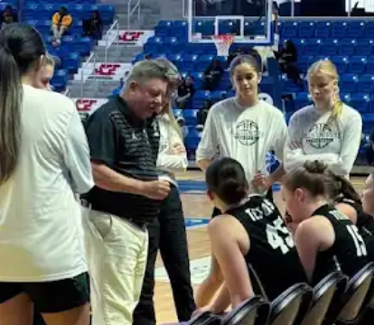
BILL

Slide 5
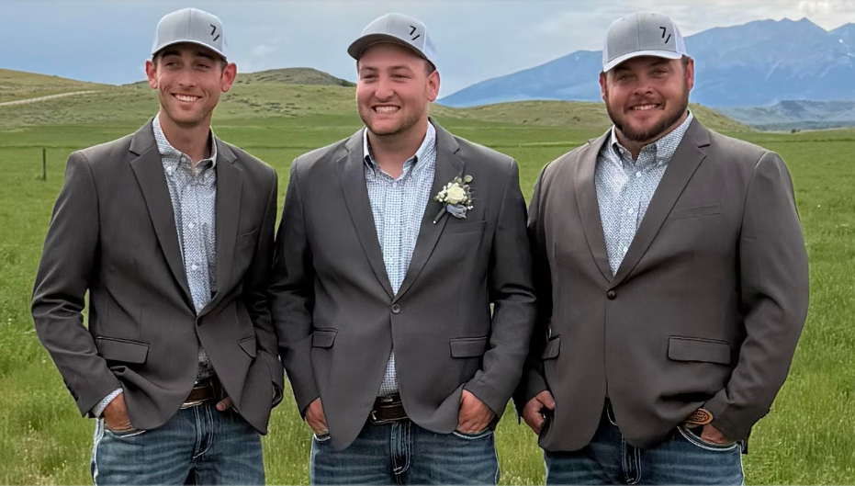
MY FAMILY

Slide 6
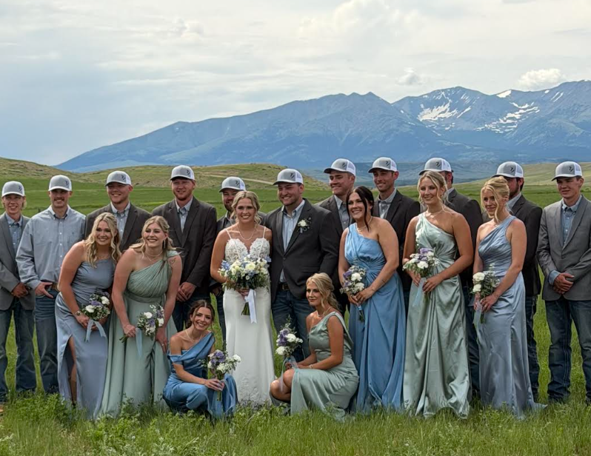

Slide 7
TIMES HAVE CHANGED?
Underneath it all…
  The core values of what shape and direct a solid school-based activities program are still the same as they always have been.
  Today, I will share with you what I have found to be at the heart of what we do.
  Coaching perspective ☺

Slide 8
1. GAME PLAN
So critical!
Map out your season, your year
  High standards, yet achievable
  Create a season calendar
    Understand time frames, find your deadlines
  Weekly plans
    Activities go out
  Game Day plans!
  PREPARE FOR THE NOW—
  BUT ALWAYS BE FORWARD THINKING!
  **BE READY TO PUNT
  Mr. G and BB plans

Slide 9
2. ANTICIPATE
Listen to instincts
Prevent defense – be alert and aware
Look for safety issues - minimize risks
Know who you’re dealing with and consider approaches to defusing situations before they become situations
Be present;
Be alert!
Jerry Callen

Slide 10
3. WORK ETHIC
High motor person – role model (preK)
Job is tough and tiring, but worth it
Remember:
  We are creating positive learning and growing experiences for young people in their formative years.
  We are giving opportunities for kids to put those skills to the test, to try them out, and to hopefully elevate and add those experiences to their “bag of tricks” for a successful life.
    For me, most rewarding
part of the job/watching ppl experience & enjoy!…lustre

Slide 11
4. PUT TOGETHER YOUR TEAM—
KNOW THEM, ID ROLES
  Network with other AD’s
    Advice, reminders, support system (MHSA, MIAAA, conferences)
  Get to know your hired staff
    Coaches, office staff
  Find your stakeholders, those who have been supporters in the past, and those who want to support but maybe don’t know it yet
  Get to know your athletes
  Get to know your parents
  Pull all together, ID where they fit, train them (Co-oo)

Slide 12
Respect what they bring to the table and their perspective
Thank them!

Slide 13
5. CONSISTENCY & REPS
“You play like you practice.”
Develop routines that allow your program, events, games, etc, to grow, thrive, and operate smoothly.
  Save your “stuff”
  Organize your “stuff”
  Steal other people’s “stuff”
Be present, reflect, and adjust…
noting how to get better for next time…Girls championship

Slide 14
6. ADAPT AND LEARN
Continue to build your “bag of tricks” – your skill set
  Teach people what you need/expect and how you need them to do something (MS track)
Old days – No need to “teach an old dog new tricks!”
  Phone calls, faxing, in person scouting
    HUMAN CONNECTION
New days—The old dog must learn a few new tricks!
  Email, Google Suite, digital meetings
    Faster, more efficient, probably more accurate

Slide 15
Never underestimate the power of human connection…
a handshake, looking someone in the eye,
a pat on the back, a smile! (State track)
EFFECTIVE CHANGE
TAKES TIME!
KEEP PERSPECTIVE.

Slide 16
And, now…TIME TO PLAY THE GAME—
JUST REMEMBER
At the core of your AD experience, you can count on a few things:
  Thick skin
  Challenges and pressure
  Long days
  Tired body
  Mind racing
  Confident but not cocky
  THE GAME HAS 4 QUARTERS,
  BUT THERE IS A PRE-GAME, QUARTER BREAKS, ½ TIME, AND POST GAME FOR A REASON. (Fariview BB)

Slide 17
AT THE END OF THE GAME (DAY)…
You are a real person, with a life outside of the job
You need to rejuvenate yourself
  Be intentional about this
  Find your people who bring joy, laughter, and a break to your job life
    You must take breaks..short ones (time outs), longer ones (quarter breaks & half time), season breaks (between seasons, holidays, summer)
Never forget who/what is most important to you
and protect that time

Slide 20
AD PARADOX: Be a cautious risktaker!
Rely on tried and true tactics, routines, traditions
Look for implementation of new ideas that will benefit your programs, your coaches, your school, and ultimately your community
BUILD YOUR CULTURE –
A work in progress

Slide 21
NEVER FORGET WHY YOU DO WHAT YOU DO
& WHO YOU ARE DOING IT FOR
Not for status!
Effective change takes time and persistence
Job gets somewhat easier the more you reps you put in

Slide 22
We are working to create programs which provide experiences that teach young people about life through healthy, positive competition.
  Build on the understanding of how important a school system is to a community & the value of opportunity for young people to learn curriculum and master concepts, but to also offer opportunities for students to belong, to feel a sense of pride, and to find school-based experiences to fuel their passions, whatever they may be. (Daryl Varia)

Slide 23
NO BETTER PLACE TO DO THAT THAN THROUGH SOLID, SUCCESSFUL
CO- & EXTRA-CURRICULAR ACTIVITIES

Slide 24
THAT’S
US!

Slide 25
GOOD LUCK &
Thank you!
Contact Kara: ktriplett@lambertschool.net
406-480-1559
!

