Slide 1
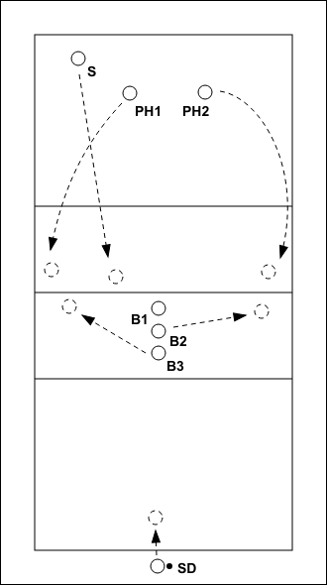
Creating Intentional Volleyball Practices That Transfer to Game Day
Design strategies to improve performance during matches
Presented by Scott Keister
Head Volleyball Coach
Montana State University - Billings
Notes:
---

Slide 2
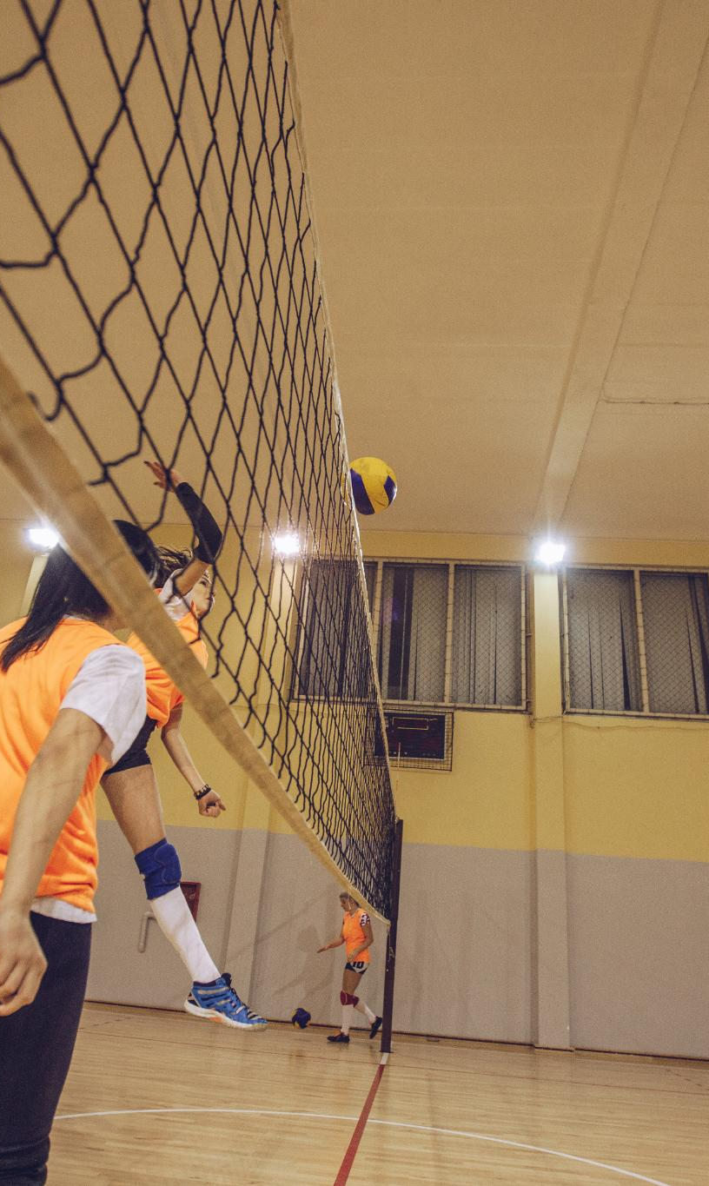
What Transfer Really Means in Volleyball
  Applying what you learn in practice to the game.
  The game teaches the game.
  Performance-based training reduces the gap between practice and match.
  The closer practice resembles competition and game-like training, the more prepared and confident athletes become.
  Confidence comes from repeatedly experiencing game-day challenges in practice.
Notes:
Practice-to-game transfer in volleyball refers to the degree to which behaviors, decisions, and skills trained in practice reliably appear under the pressure and complexity of competition. For coaches, this means shifting the focus away from whether athletes can execute a skill in a controlled environment and toward whether they can apply that skill in dynamic, unpredictable match situations. Transfer is not automatic; it must be intentionally designed. Volleyball is a sport defined by rapid perception–action coupling, where players must read cues, make decisions, and execute skills in fractions of a second. If practice removes or simplifies those cues too much, athletes may become proficient at drills but struggle when those same skills are required in games. True transfer occurs when athletes recognize similar patterns between practice and competition and respond appropriately without excessive conscious thought. This requires practices that include realistic game cues such as serve trajectories, hitter approach angles, setter decisions, and opponent tendencies. Additionally, transfer is supported when practice outcomes are clearly connected to match outcomes—such as scoring, side-out efficiency, or transition success—rather than arbitrary drill completion. Coaches must also consider psychological transfer: confidence, communication, and decision-making under stress. When athletes experience competitive consequences, time pressure, and scoring systems in practice, they are more likely to respond effectively on game day. Ultimately, defining transfer clearly helps coaches evaluate whether their practice design is truly serving its intended purpose or simply creating the illusion of improvement.

Slide 3

Whole vs. part
  Whole is better than part, but there is a place for part.
  Whole – Part – Whole
  Teach the whole action first through demonstration
  Work on a part, then back to whole.
  Repeat for another part at necessary
Notes:
Practice-to-game transfer in volleyball refers to the degree to which behaviors, decisions, and skills trained in practice reliably appear under the pressure and complexity of competition. For coaches, this means shifting the focus away from whether athletes can execute a skill in a controlled environment and toward whether they can apply that skill in dynamic, unpredictable match situations. Transfer is not automatic; it must be intentionally designed. Volleyball is a sport defined by rapid perception–action coupling, where players must read cues, make decisions, and execute skills in fractions of a second. If practice removes or simplifies those cues too much, athletes may become proficient at drills but struggle when those same skills are required in games. True transfer occurs when athletes recognize similar patterns between practice and competition and respond appropriately without excessive conscious thought. This requires practices that include realistic game cues such as serve trajectories, hitter approach angles, setter decisions, and opponent tendencies. Additionally, transfer is supported when practice outcomes are clearly connected to match outcomes—such as scoring, side-out efficiency, or transition success—rather than arbitrary drill completion. Coaches must also consider psychological transfer: confidence, communication, and decision-making under stress. When athletes experience competitive consequences, time pressure, and scoring systems in practice, they are more likely to respond effectively on game day. Ultimately, defining transfer clearly helps coaches evaluate whether their practice design is truly serving its intended purpose or simply creating the illusion of improvement.

Slide 4
Purposeful Practice Design
Purpose Effeciency
Effectivness Progression
Notes:
Establishing Clear Purpose for Every Drill, Aligning Practice Goals With Match Outcomes

Slide 5

Purpose
Purpose Defines Practice Design
  Every drill should have a clear tactical or technical goal tied to competition needs.
Match Analysis Drives Purpose
  Using statistics, video, or observation helps identify problems to target in practice.
Communicating Purpose Boosts Engagement
  Explaining drill objectives increases athlete focus and motivation during practice.
WHY? – Athletes should ask this question as well as coaches.
Notes:
Purpose is the foundation of intentional practice design. Every drill, game, or activity in practice should have a clearly defined reason for existing, directly tied to a tactical or technical need identified in competition. Purpose answers the question: what match problem are we trying to solve? Without this clarity, practices can become collections of familiar drills rather than targeted development opportunities. Establishing purpose begins with match analysis, whether through statistics, video review, or coach observation. Once a problem is identified—such as poor first-ball side-out, ineffective transition offense, or late defensive reads—the coach can design practice activities that specifically address those issues. Purpose also needs to be communicated to athletes. When players understand why they are doing an activity and how it connects to match performance, engagement and focus increase. Additionally, purposeful drills prioritize decision-making over rote repetition. For example, rather than simply passing balls to a target, athletes might be required to choose serve-receive seams or adjust platform angles based on server cues. Purpose-driven practice also helps coaches make better decisions about time allocation. If an activity does not clearly serve a competitive objective, it may need to be modified or removed. Over time, consistently emphasizing purpose builds a practice culture where both coaches and athletes expect every minute on the court to contribute meaningfully to game-day success.

Slide 6
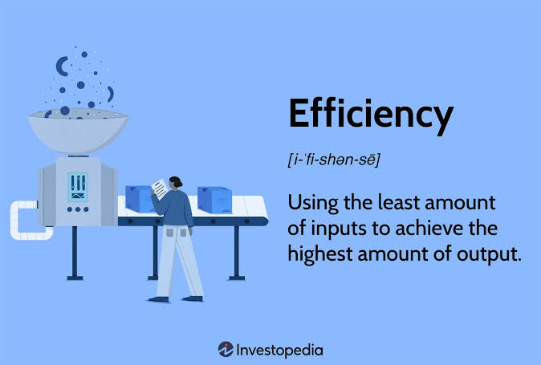
EFFICIENCY
(the process)
Effective practices allow coaches to accomplish more in less time while creating an environment where athletes learn, compete and improve at a higher rate.
The goal is not to cram more drills into practice – it’s to maximize meaningful learning opportunities with the time you have.
Maximize contacts (physical and verbal)
High athlete engagement
Use of courts, equipment and personnel
More player action than coach instruction
Notes:
One of the most common traps in coaching is equating drill success with volleyball success. Athletes may pass perfectly to a target, hit lines uncontested, or run clean offensive patterns in practice, yet fail to reproduce those outcomes in matches. This disconnect often occurs because drills isolate skills from the context in which they are actually used. Volleyball success, however, depends on integrating multiple skills while reading opponents and adjusting in real time. For example, a perfect pass in a drill has limited value if the athlete cannot achieve a playable pass against a tough server with tactical intent. Coaches should therefore evaluate drills by asking whether success in the drill requires the same decisions, timing, and execution demands as the game. Another key difference is accountability. In matches, every rally has a consequence that affects the score, momentum, and emotional state of the team. Practices that lack scoring, competition, or consequences often fail to replicate this environment. Additionally, volleyball success is collective, not individual. Many drills reward individual execution without requiring communication, coverage, or transition responsibilities. To move from drill success to volleyball success, coaches should design practices that emphasize game outcomes such as side-out percentage, transition scoring, and point scoring under specific constraints. By redefining success in practice to align with match objectives, coaches help athletes internalize what actually matters on game day and develop habits that hold up under pressure.

Slide 7
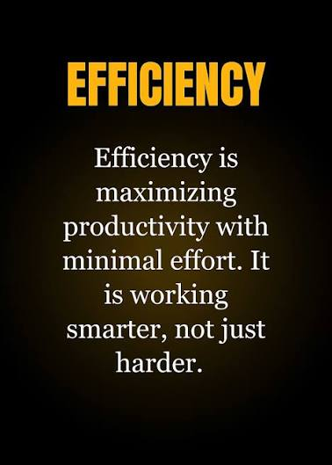
Maximizing Efficiency: Time, Touches, and Organization
Maximize Meaningful Repetitions
  Design drills that reduce waiting time and increase ball contacts per athlete for maximum practice value.
Organized Practice Planning
  Plan practices down to the minute including transitions, equipment setup, and clear communication to maintain flow.
Use of Staffing and Space
  Utilize assistants and players for ball feeding, scoring, and play initiation to increase practice tempo and efficiency.
Balance Efficiency and Quality
  Ensure high tempo drills have clear objectives to avoid chaotic practice that reduces learning quality.
Notes:
Efficiency in volleyball practice refers to maximizing meaningful repetitions while minimizing wasted time. Given limited practice hours, especially at the high school and club levels, coaches must be intentional about organization, transitions, and communication. Efficient practices keep athletes moving, engaged, and challenged. This starts with thoughtful drill design that reduces standing in lines and increases ball contacts per athlete. Small-sided games, wave drills, and continuous play formats are effective ways to increase touches while maintaining intensity. Clear instructions and demonstrations are also critical; long explanations reduce active time and break rhythm. Many coaches benefit from planning practice down to the minute, including equipment setup and transitions between activities. Efficiency also involves staffing and space usage—using assistants or athletes to feed balls, manage scoring, or initiate play can significantly increase tempo. However, efficiency should not come at the expense of quality. High-tempo chaos without clear objectives can be counterproductive. The goal is efficient use of time in service of learning and transfer. By auditing practices for wait time, coach talk percentage, and touches per minute, coaches can identify opportunities to improve efficiency and create a more productive training environment.

Slide 8

EFFECTIVENESS
(The Outcome)
Evaluate Performance regularly (Individual & Team)
Drill Success rate (70% rule)
Improved Performance in Matches
Quality execution under pressure
  Is this helping our athletes perform better when it matters most?
Notes:
Aligning practice goals with match outcomes ensures that improvement in practice translates directly to improved performance in competition. This alignment requires coaches to think in terms of volleyball outcomes rather than isolated techniques. Match outcomes include metrics such as side-out efficiency, points scored in transition, serve pressure, and defensive conversion rates. When practice goals mirror these outcomes, athletes learn to prioritize the same things in practice that matter on game day. For example, instead of counting total reps, a practice might track how many points are scored off a controlled first contact or how often a defensive dig leads to a transition swing. This approach shifts attention from activity volume to effectiveness. Alignment also involves designing scoring systems that reinforce desired behaviors. If a team struggles with aggressive serving, awarding bonus points for serving aces or forcing out-of-system passes can reinforce that emphasis. Furthermore, aligning goals helps coaches evaluate progress more accurately. If practice statistics improve but match performance does not, it may indicate that practice lacks representativeness or sufficient pressure. By consistently tying practice goals to match outcomes, coaches create a clear feedback loop that informs practice design, athlete development, and tactical adjustments throughout the season.

Slide 9
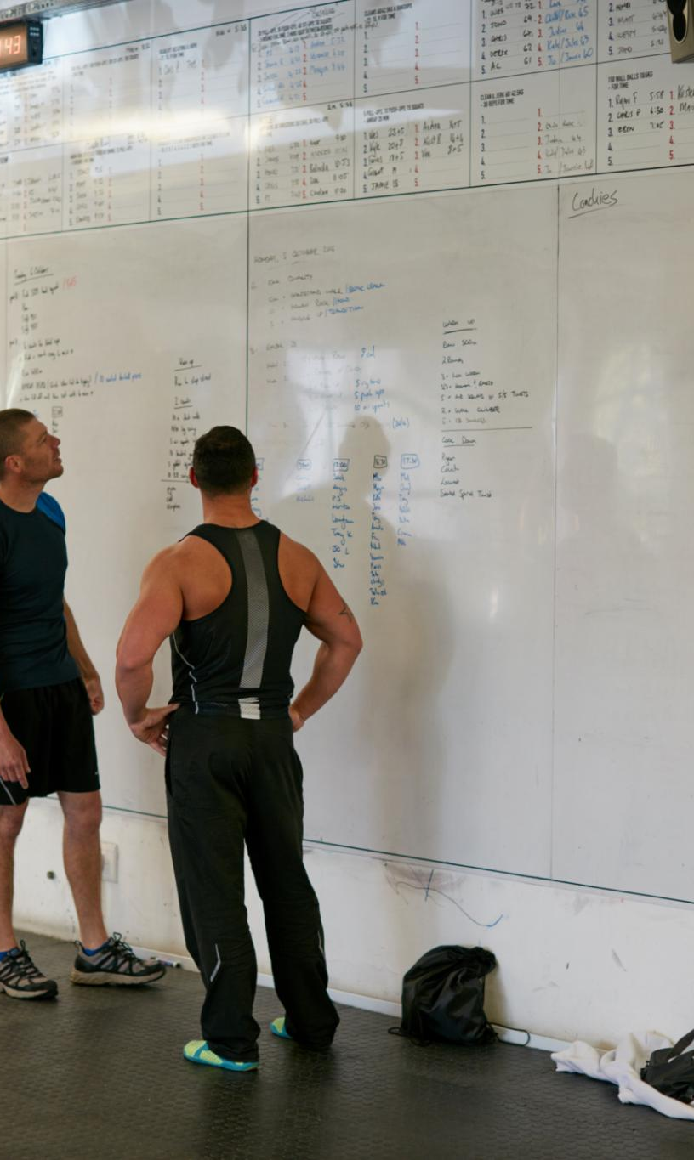
Ensuring Effectiveness Through Measurable Outcomes
Measurable Success Criteria
  Effective practices include clear success criteria and measurable outcomes that closely reflect match performance.
Behavior Shaping Constraints
  Adjusting constraints like court size and scoring rules helps guide athletes toward desired behaviors without constant correction.
Reflective Learning
  Brief discussions and reflective questions help athletes link actions to outcomes and reinforce their learning.
Intentional Practice Design
  Evaluating effectiveness over activity completion makes practice design more adaptive and impactful across the season.
Notes:
Effectiveness goes beyond how busy a practice looks and focuses on whether athletes are actually improving in ways that matter. Effective practices include clear success criteria and measurable outcomes that align with match performance. This might involve tracking side-out percentage during wash drills, recording defensive conversion rates, or evaluating setter decision quality under pressure. Measurement does not need to be overly complex; even simple scoring systems can provide valuable feedback. The key is that athletes know what success looks like and receive immediate information about their performance. Effectiveness is also enhanced by constraints that shape behavior. By adjusting court size, number of contacts, scoring rules, or available options, coaches can guide athletes toward desired solutions without constant verbal correction. Reflection is another component of effectiveness. Brief discussions or questions between reps can help athletes connect actions to outcomes and reinforce learning. Ultimately, an effective practice produces observable changes in athlete behavior during competition. When coaches consistently evaluate effectiveness rather than activity completion, practice design becomes more intentional, adaptive, and impactful over the course of a season.

Slide 10

Building Logical Progressions That Increase Challenge
progression
Intentional Sequencing
  Progression involves sequencing practice activities to gradually increase difficulty and prepare athletes effectively.
Flexible Challenge Adjustment
  Coaches adjust challenge levels based on athlete performance to keep progress optimal and balanced.
Building Confidence and Resilience
  Well-designed progressions build athlete confidence, adaptability, and resilience for consistent performance.
Game-like Practice Design
  Practice should mimic real game conditions with authentic opponent behavior and positioning to improve decision-making.
Emotional and Psychological Realism
  Incorporating scoring and competitive pressure in practice helps athletes handle game-day emotions and momentum.
Notes:
Progression is the intentional sequencing of practice activities to gradually increase difficulty and better prepare athletes for competition. Effective progressions move from simple to complex, from controlled to chaotic, and from low pressure to high pressure. In volleyball, this often follows a teach–stabilize–stress–compete model. Athletes may first learn or review a concept in a simplified setting, then stabilize execution through repetition, before being stressed with added speed, decision-making, or scoring. Finally, competitive elements are introduced to simulate match conditions. Progression ensures that athletes are neither overwhelmed nor under-challenged. It also allows coaches to layer skills and tactics over time, such as combining serve-receive patterns with transition offense. Importantly, progressions should be flexible; if athletes are not meeting performance benchmarks, coaches may need to adjust the level of challenge. Well-designed progressions help athletes build confidence, adaptability, and resilience, all of which are essential for consistent game-day performance.

Slide 11

Application and reflection
Backward Design Approach
  Start by identifying key match problems to create practice activities addressing them directly.
Focus on Critical Phases
Design drills emphasizing game phases that most influence winning, like side-out or transition scoring.
Critical Reflection and Adjustment
  Coaches must continuously reflect and adapt practices to maximize efficiency and measure effectiveness for athlete development.
Key Coaching Questions
  Asking questions about athlete decisions, cues, outcomes, and relevance to game performance creates more impactful training sessions.
Creating Optimal Learning Environments
  Coaches foster environments focused on learning, competitiveness, and transfer to prepare athletes to perform under pressure.
Notes:
Designing intentional practices begins with identifying the most important match problems and working backward to create activities that address them. This backward design approach ensures that every segment of practice contributes to a clear competitive objective. Coaches might start by asking which phases of play most influence winning for their team, such as first-ball side-out or transition scoring. From there, they can design competitive games, wash drills, and constrained activities that emphasize those phases. Supporting activities can then be added to develop the technical and tactical components required for success. This approach also encourages coherence across the practice plan, as each activity builds toward a common goal. By consistently designing practices in this way, coaches develop a repeatable process that adapts to different opponents, phases of the season, and team needs.

Slide 12


Questions and discussion

