Slide 1
Elite Level MINDSET
ENGINEERING AN

Slide 2
Top Mental concerns
Dealing with disappointment
Worry about what others think
Shutting down mentally
Resilience
Being able to take criticism
Over thinking
Lack of Confidence
Recovering from mistakes
Fear of failure
Timidity
Negative self-talk
Under achieving

Slide 3
One thing to master mentally this season
Strategies to fix mistakes
Awareness
Preparing them for the real world
Accountability
Challenged with something new - resilience
CONFIDENCE
Short term memory
Focus - staying present
Learning not to shut down
Strategies for parents

Slide 4
Defining confidence
The single most critical factor behind human performance. *
It is the most consistent factor found between high performing and lower performing individuals.
Confidence: trusting the cause will equal the effect
If I do this - this will happen
Confidence is SKILL - it can be learned
*Vealey, R. S. (2001). Understanding and enhancing self-confidence in athletes. In R. N. Singer, H. A. Hausenblas, & C. M. Janelle (Eds.), Handbook of Sport Psychology (2nd ed., pp. 550–565). John Wiley & Sons.

Slide 5
Profiling confidence
Where we think confidence comes from
Ego - false (outcome/comparison)
Aggressive - false (outcome/comparison)
Assertive - true (task/process)
Passive - false (comparison/outcome)
Pessimistic - false (comparison)
CONFIDENCE
*Craig Manning, The Fearless Mind: 5 Essential Steps to Higher Performance

Slide 6
Ego
EGO - approval
Aggressive - false confidence
Assertive - true confidence
Passive - no confidence at all
Pessimistic - don’t even try
Rooted in comparison
Perfection (so that others will like me)
Always seeking approval from others
Motivation becomes based on what others think of me

Slide 7
aGgressive
EGO - approval
Aggressive - false confidence
Assertive - true confidence
Passive - no confidence at all
Pessimistic - don’t even try
False Confidence - Rooted in comparison
I am great / You stink
Aggressive people get their confidence from being better than others
Only feel good about themselves if they are the best in the room
Some of these athletes are born on 3rd base - they have performed well without effort
Try to lift themselves up and put others down - so they can relax and execute
Maybe not well liked - but respected (usually thru fear)
No potential to get better - because all that is cared about is being better than others

Slide 8
Passive
EGO - approval
Aggressive - false confidence
Assertive - true confidence
Passive - no confidence at all
Pessimistic - don’t even try
I stink / you’re great
Rooted in comparison
Always putting themselves down - thinking that somehow other people are more superior to them in some way
Focus on what they are not doing well
Walk into the gym and compare themselves to their competition then rank themselves
People pleasers - usually well liked - maybe not a lot of respect

Slide 9
Assertive
EGO - approval
Aggressive - false confidence
ASSERTIVE - TRUE CONFIDENCE
Passive - no confidence at all
Pessimistic - don’t even try
True confidence
“I am good and so are you “- SO LETS COMPETE
Good without any comparison
Dependent on my skill set, If I don’t have it I GO TO WORK and get it
If someone beats me because they have better skills than me - so be it - but I didn’t beat myself in competition.
Set goals about what they want TO DO - NOT ON BEATING OTHERS - the moment you focus on beating others you will play to their level
Attend to things they have direct control over - SKILL SET
Play the game of life to win not to beat others
Always asking themselves “AM I GETTING BETTER?”
Passionate about seeing how good they can execute the skills

Slide 10
Confidence Barriers
Outcome orientation (things we have NO control over)
What others think
Winning losing
Results
College offers
Comparison
What others think
Being better than someone else
Negative self talk
Outcomes
Comparison

Slide 11
Engineering High Performance
Condition the mind
Program the mind for high performance
Confidence is a SKILL
Trying to improve the behavior without improving the thought - uphill battle
Mental leads the physical
Train the mind like you train the body -

Slide 12
(LPT) Low performance thought
Law of attraction
Circumstance
CIRCUMSTANCE: Missing shots around the rim.
THOUGHT: I suck at finishing around the rim - If I go in there I am going to get stuffed - if I don’t figure this out, I am not going to get to play
FEELING (EMOTION): Frustrated/ fear
ACTION: Fade away, Avoid going to the rim, ruminate, get tentative, hesitate, avoid working on it, over think (turns to selfish play), body language shifts
RESULT: Continue to miss shots at the rim (or not take any shots at the rim
Action
Thought
Feeling

Slide 13
#1 Saboteur of high performance is Negative self talk
Conscious
5%
Average human thinks 30,000-50,000 thoughts a day
77% of those are negative and counter- productive*
95%
Subconscious
*Craig Manning, The Fearless Mind: 5 Essential Steps to Higher Performance (p. 23)

Slide 14
Bottom 10%
10-80-10
Doom and groomers -
“Your genetics determine your lot in life”
Why try - why put in the effort
They try to pull others down because they haven’t maximized their potential and they don’t want to see others reach their dreams
What isn’t happening - what is going wrong
WE DON’T WANT TO GIVE UP ON THIS GROUP
You have to be very skilled at motivating them the right way

Slide 15
Middle 80%
10-80-10
Average, mediocre and slow progressing
This is average - but we aren’t trying for average - we are trying for elite. We want top 10%
Identify the error and never learn from it
When we focus on what we are dong wrong (Whatever we focus on grows) it inflames it
Never make a plan on how to fix it
`Focus too much energy on what NOT to do. Always focusing on the negative
Get stuck in the rut of - “I missed, here we go again.” “My back hand sucks - its never going to change.”

Slide 16
Top 10%
10-80-10
Elite performers
Learn from what they are doing well
Constantly improving and enhancing skill sets
High performing teams
Strong leaders
Effective - flexible - embrace challenges

Slide 17
Middle 80%
10-80-10
Average, mediocre and slow progressing
This is average - but we aren’t trying for average - we are trying for elite. We want top 10%
Identify the error and never learn from it
When we focus on what we are dong wrong (Whatever we focus on grows) it inflames it
Never make a plan on how to fix it
`Focus too much energy on what NOT to do. Always focusing on the negative
Get stuck in the rut of - “I missed, here we go again.” “My back hand sucks - its never going to change.”

Slide 18
Building Confidence
Confidence is the most critical factor in high performance - how do we build it?
1. Previous Performance Accomplishments
2. Vicarious Experience
3. Verbal Persuasion
4. Physiological states
Bandura, A. (1977). Self-efficacy: Toward a unifying theory of behavioral change. Psychological Review, 84(2), 191–215.
https://doi.org/10.1037/0033-295X.84.2.191

Slide 19
Previous Performance Accomplishments
What we have done in the past
ACCURRATE EVALUATION
This is why very few people have true confidence.
80% what we did wrong - we focus on what we didn’t get done -
So many athletes do not have the ability to identify what the problem actually is
If you ask a player why they did not perform well, likely, you will discover it has no relation to what really happened
You cannot get better if you do not understand exactly what the problem is
CAPTURE WHAT YOU DID WELL EACH DAY
If you focus on what you are not doing - you are literally killing your confidence

Slide 20
Evaluate (strengths)
3 things you did well
Capture the skill set you performed well
As you become more aware of your strengths you will position yourself to leverage them better
Accelerate growth!! (Top 10%)
Do not evaluate yourself based on the OUTCOME (things you do not have direct control over-winning/losing, stats, playing time, making/missing)
When you evaluate on things you do not have direct control over - you set yourselves up for failure.
Evaluate yourself on the PROCESS (performance) what you do have direct control over.

Slide 21
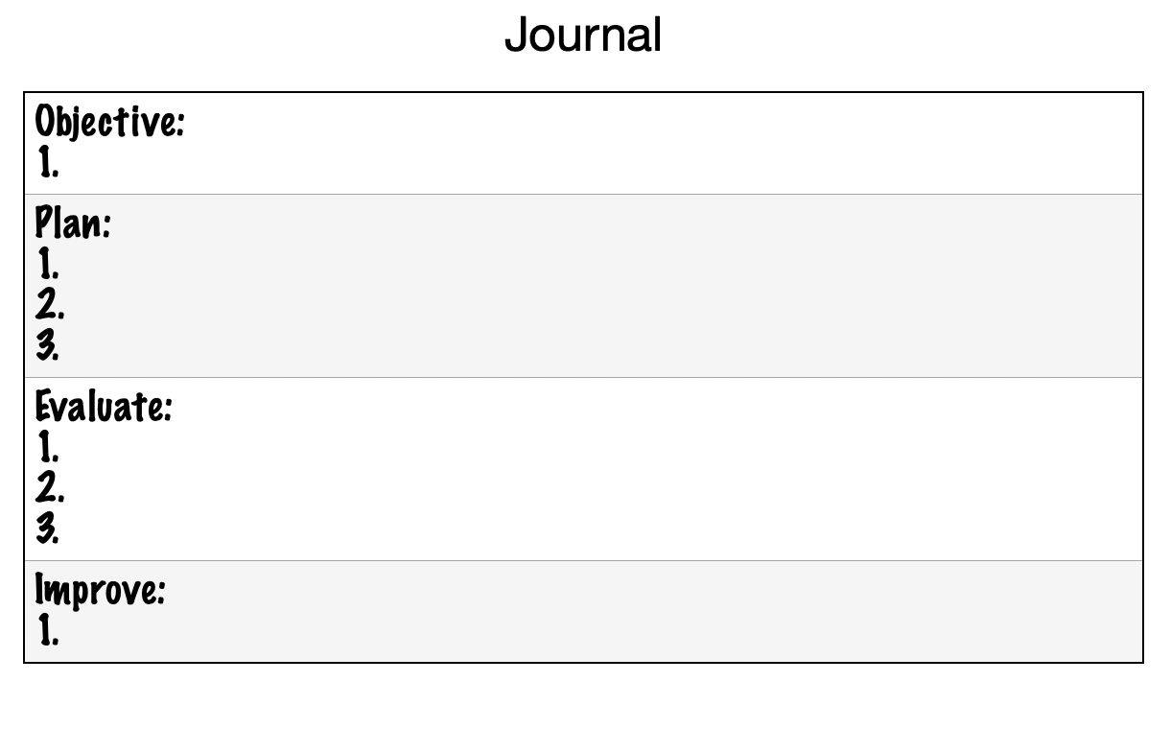
Mental Skills Journal
High Performance isn’t about being better than someone else -
Its about enhancing your own skill set
Based on the Journal of Dr Craig Manning.
*Craig Manning, The Fearless Mind: 5 Essential Steps to Higher Performance (p. 31)

Slide 22
Journal
Objective
Before Competition
This mindset enables us to develop skill sets more rapidly- allowing us to live in the moment and learn from experiences the first or second time around.
Objective: What do I want to get better at
Plan: What is my plan to accomplish that
Evaluate: What did I do well
Improve:What is one area I want to improve in
Relevant Cues:
What do I want to get better at today?
Improve
What weakness do I want to improve?
What is my plan?
Plan
What did I do well?
After Competition
Evaluate

Slide 23
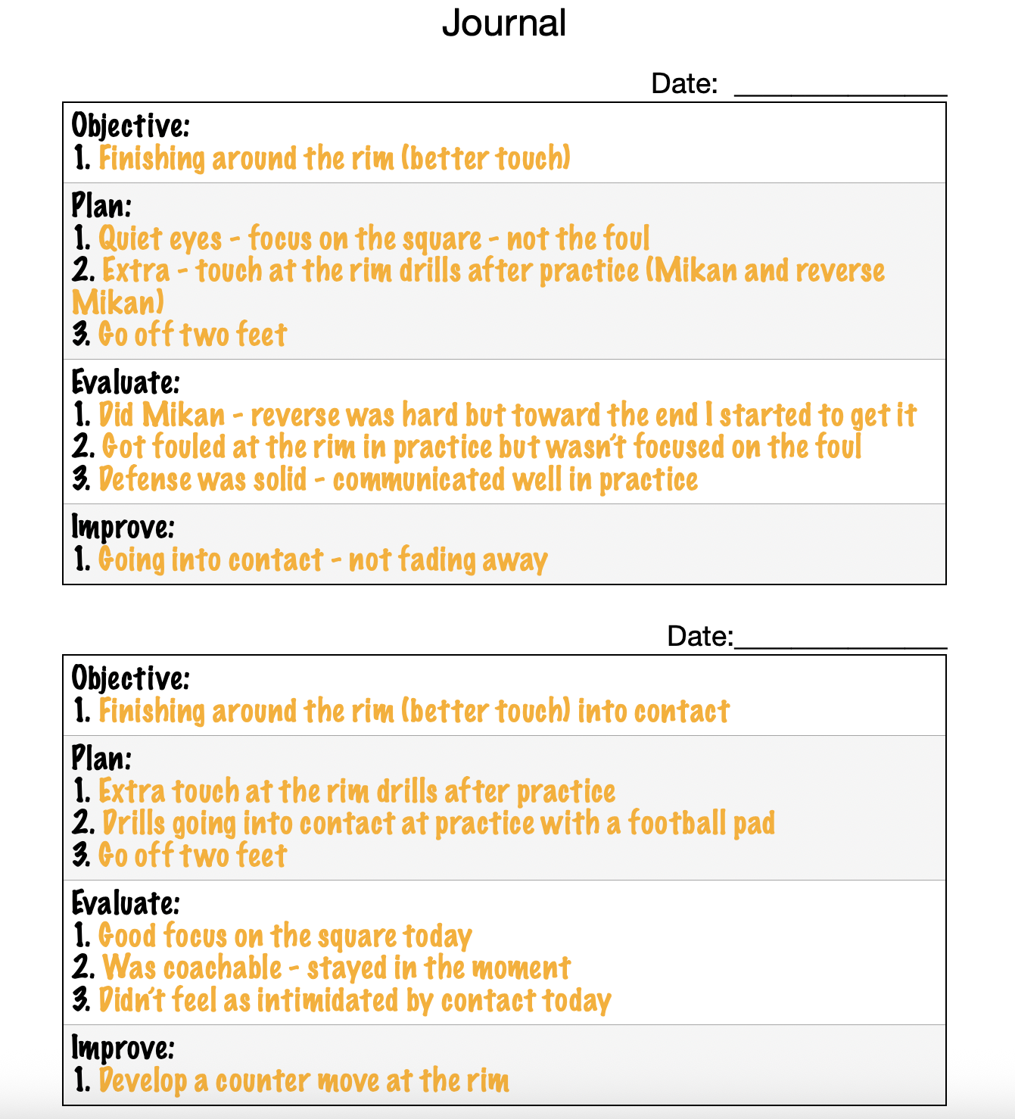
“Growth will always be more rapid when we learn from what we do well.”
Dr. Craig Manning
- The Fearless Mind

Slide 24
Jeff Graham - Head Women’s Basketball Coach - Montana tech
Game goals - green=good, blue=ok, red=needs improvement
Florence - Catch shot ready (square up), talk when tired on D, crash “O” boards *boxout, dribbling low, taking away weak side, threat on “O”, TO (-2)
Chinook - get in paint follow, go back up with “O” boards, boxout or get around after every shot, talking on “D” (when tired), reading passes/steals (4), TO’s (-2)
Roy-Winifred - catch w/ foot ready to shoot, rip and attack gaps, don’t get stood up against pressure, have confidence, stay available (don’t hide in corner)

Slide 25
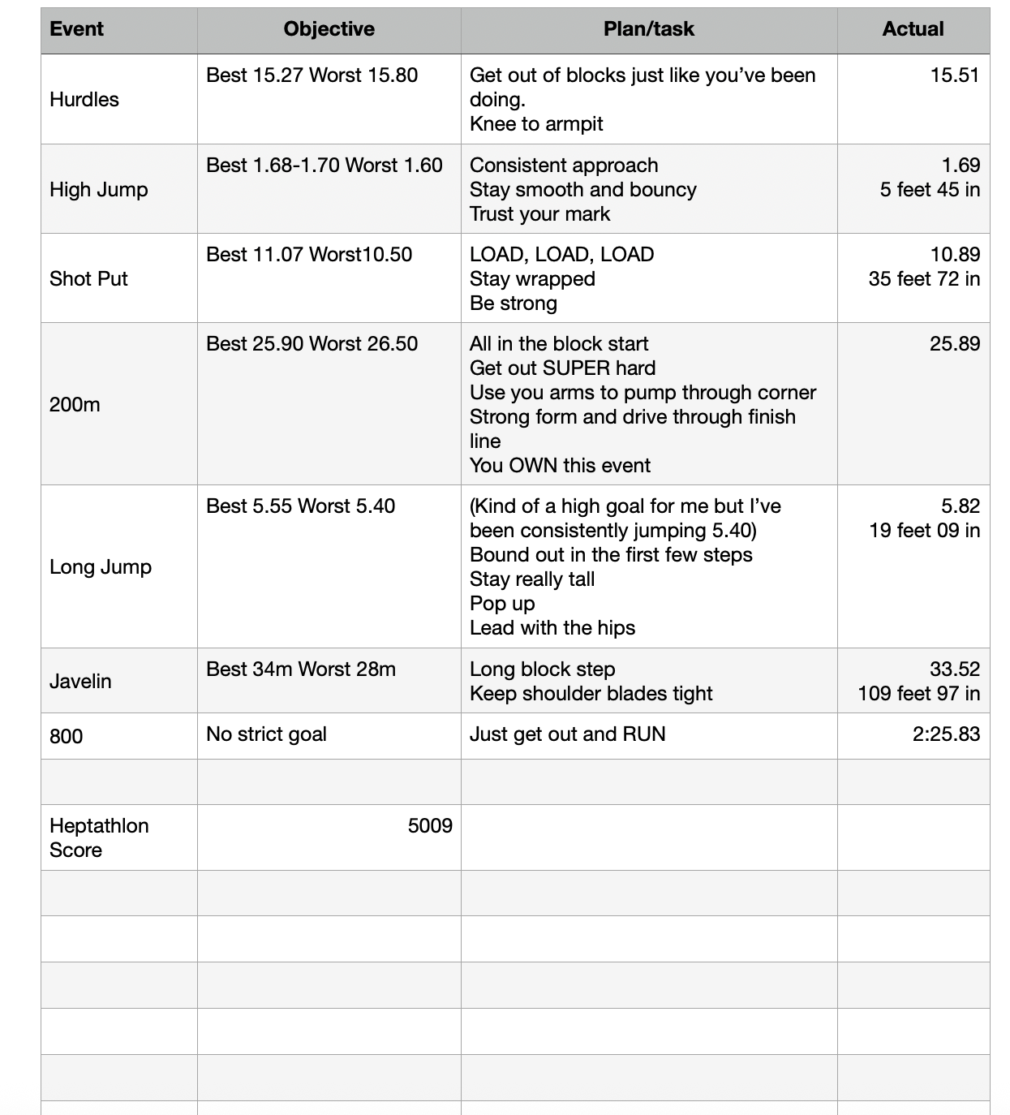

Abby Clark - Heptathlon

Slide 26
HPT - high performance Thought
Eyes on square
CIRCUMSTANCE: Missing shots around the rim
THOUGHT: Focus on the square, go up strong, two feet, YOU’VE GOT THIS
FEELING: Engaged
ACTION: Stay engaged in the game, bring energy, maintain good body language, take good shots, not as hesitant, focused on the things I can control
RESULT: Give myself the best chance to have success
You’ve got this
Be strong

Slide 27
Check out the services I offer
Want more information?
1 on 1 with athletes
Team Coaching
Coaches Workshops
Parent Workshops
Teacher Workshops
Contact me at
shannongrossmancoaching@gmail.com
elitelevelmindset.com
(406) 750-7589

