Slide 5
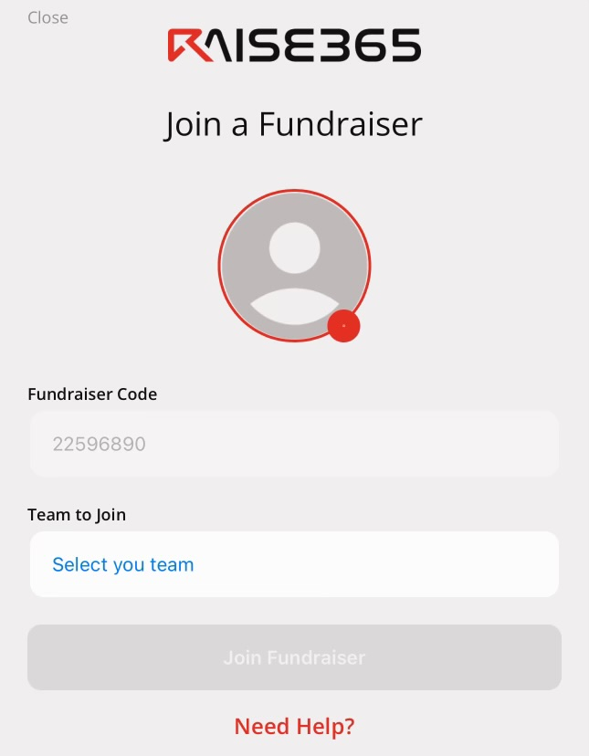
DOWNLOAD A PIC OF YOURSELF!
TYPE IN CODE!
SELECT YOUR TEAM!

Slide 6
14710957

Slide 7
CLICK ON THE PARENT/GUARDIAN SHARE
SHARE ON SOCIAL MEDIA W/ THE SHARE BUTTON
ADD CONTACTS BY SYNCING CONTACTS
OR BY MANUALLY ENTERING THEM IN

Slide 8
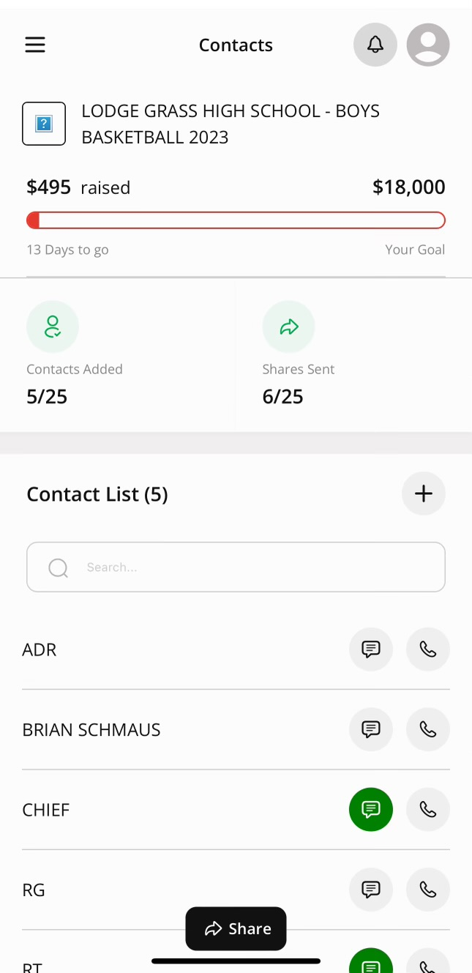
CLICK ON EACH SMS CLOUD
SEND THE LINK
TURN THEM GREEN

Slide 9
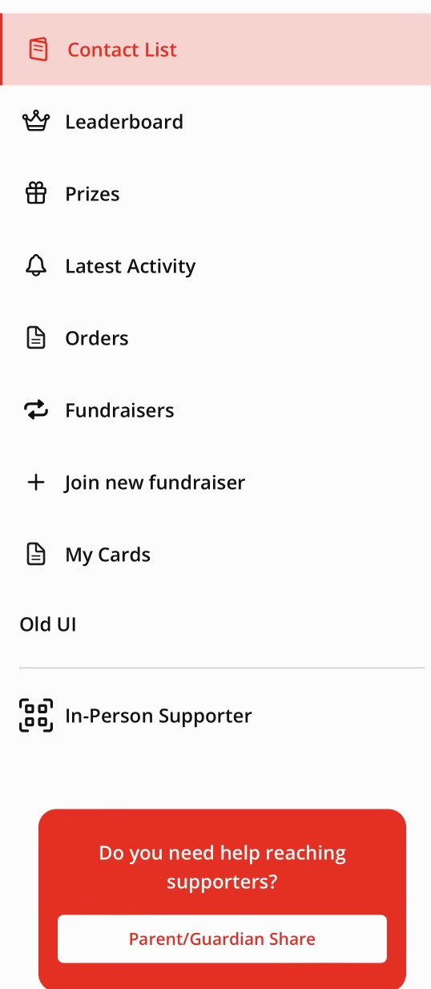
QR-CODE

Slide 10
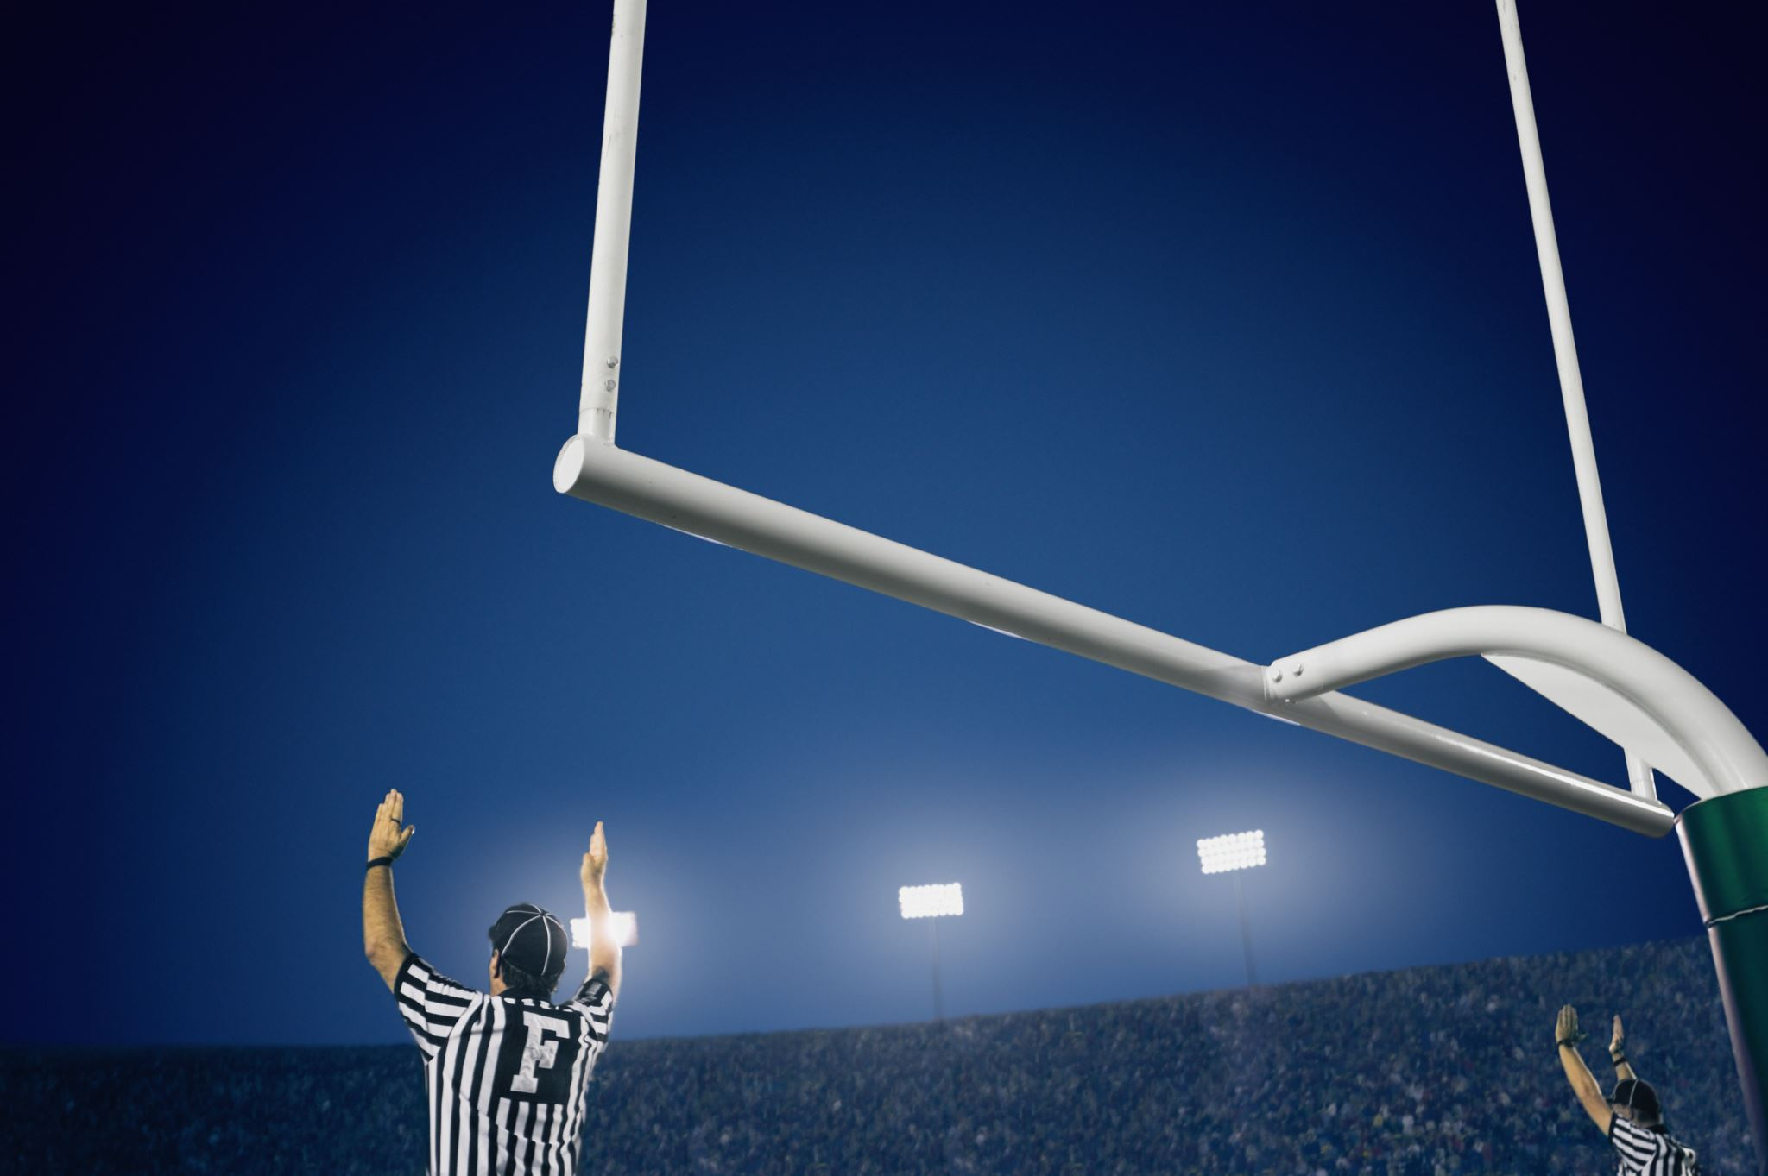
GOAL IS 25 CONTACTS
COACH CAN SEE HOW MANY SHARED CONTACTS YOU HAVE

Slide 12
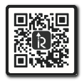
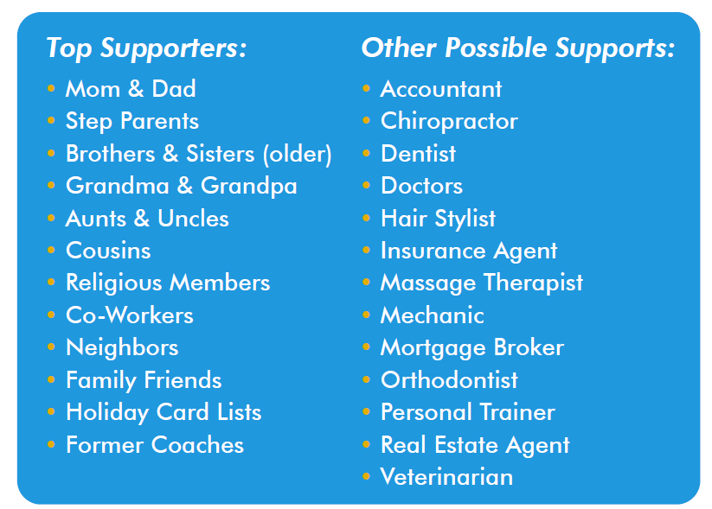
Hello Parents,
We will be launching our Adrenaline Raise365 Online Donation Fundraiser in the coming days and wanted to answer any questions you may have to GAIN participation. Fundraising is vital for the success of our program, and we truly need to raise funds. Adrenaline Raise365 Online Donation has an efficient process that helps the students raise money for a successful year.
All we ask is 2 things from you as parents/guardians, the first being that you help your student gather 25 or more cell phone numbers or email address of their biggest supporters i.e., “Parents, Grandparents, Aunts, Uncles, Cousins, Older Siblings, Family friends.” Please have the phone numbers stored in your student’s phone and on the attached call list. A text message and/or email will be sent with a donation link to each of his/her potential donors. THOSE CONTACTS ARE STRICTLY PRIVATE, PROTECTED AND WILL NEVER BE REDISTRIBUTED!!!
Secondly have your student download the RAISE365 APP on their phone. (QR Code at top of page) After they have downloaded it, they will need to “sign up” and create an account (name/number/email and most important add a photo of themselves). This info helps the potential donor in knowing exactly who the link is coming from.
We are confident there are many people eager to support your student and Adrenaline Raise365 Donation program affords them the opportunity to help. This Fundraiser will be a success if you help develop a quality list.

