Slide 1
We Are…. Eagle Football
Greg Misner
Head Football Coach
Fairfield High School (MT)
“Connecting with your players”

Slide 2
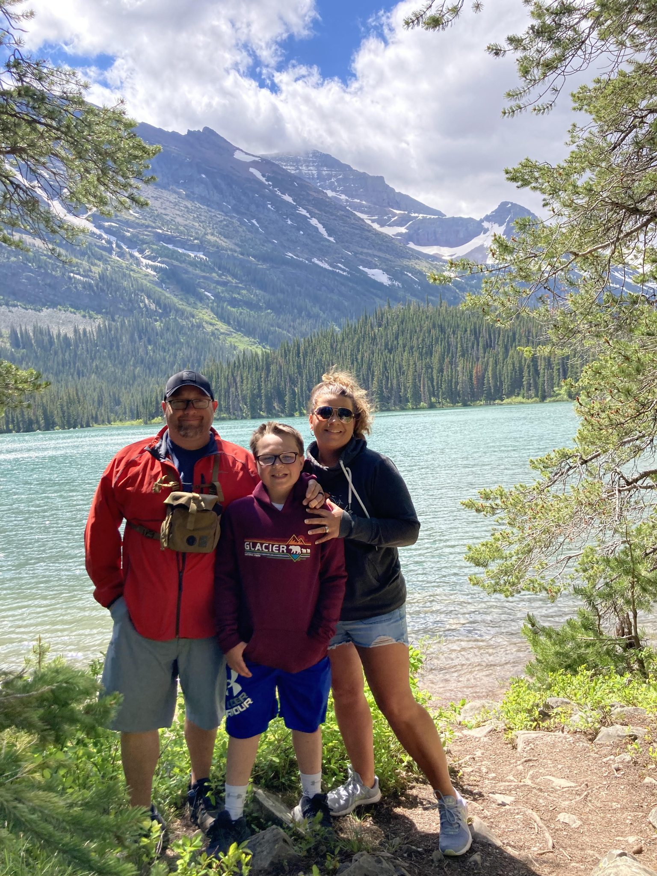
-Married 16 years
-Wife Nikki
and
son Easton

Slide 3
Coaching experience: +19 years of coaching at the high school level
Football:
Head Football Coach: Noxon (MT), Fort Benton (MT), Fairfield (MT)
Football Defensive Coordinator/ Special Teams Coordinator: White Cloud (MI), Carsonville- Port Sanilac (MI), Houghton Lake (MI)
Track and Field:
Head Coach: Noxon (MT), Carsonville-Port Sanilac (MI)
Girls Basketball:
Assistant Coach: Noxon (MT), Fort Benton (MT)
Softball:
Head Coach: Houghton Lake (MI)

Slide 4
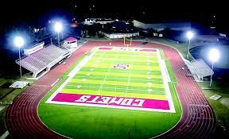
Olivet College (MI)

Slide 5
Impact: Positive Coaches
Positive Influencers:
Coach Dallas Hillar
-Head Coach Olivet College
Coach Barry Seabrook
-Head Coach White Cloud HS
Coach Eric Tunney
-Head Coach Grayling HS
Elite Level:
-One on one time
-Approachable
- Consistent
-Demanding
-Respectful
-Non-football related

Slide 6
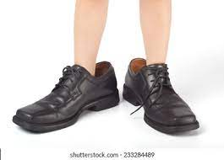
“Big shoes to fill”

Slide 7
Honor the tradition:
-No negatives about previous staff
-No comparisons
** Every school has tradition somewhere**

Slide 8
Transition
“I picked you, you didn't pick me”
-Phone call to the players
-Ask what their expectations are?
-Start to build trust

Slide 9
Transition
-New Coaching staff
-Adjusting to new terminology
-Change
- Understanding the loyalty to the previous staff
-Buy in

Slide 10
Starting the connection
How do you start to connect with players?
Care outside of football
Make the personal connection
What are your player’s motivations?
Show them “Love”

Slide 11
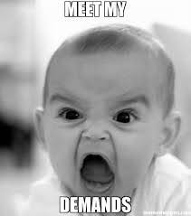
Connection: Care outside of football
Care what your players are interested in outside of football
-hunting, gaming, ranching, rodeo
Show them that you want them to succeed
Personal goals
Player profile sheet
Demand of them
You will find success

Slide 12
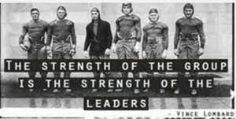
Connection: Make Connection
Connecting People & Players
-Connection statements
- “BE ELITE”
- “We Are…..”
- “Compete”
Best players are now the hardest workers on the team
- 3 positives for every 1 negative

Slide 13
Connection: Make Connection
“I told him 100 times”

Slide 14
Connection: What are your players motivations?
-Generic statements:
-“win state”
-“win our conference”
- BUT HOW???
- What's your process in your program?

Slide 15
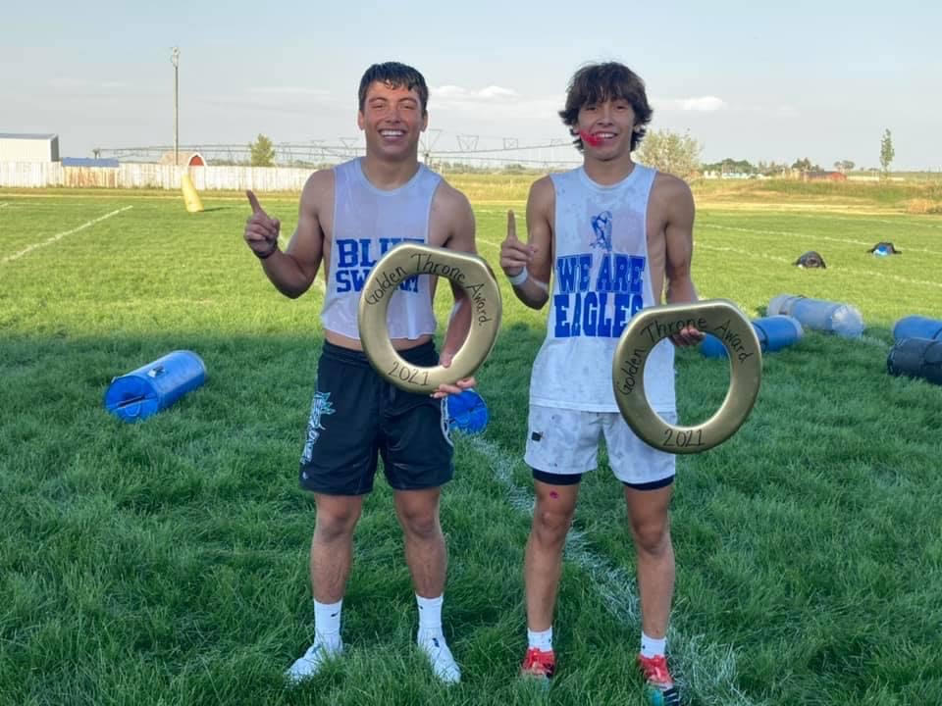
Show them “Love”
Our program is built on Love for each other
Love is shown in many ways
Being Elite
Toughness
Demanding
Understanding
Competitive
Respect

Slide 16
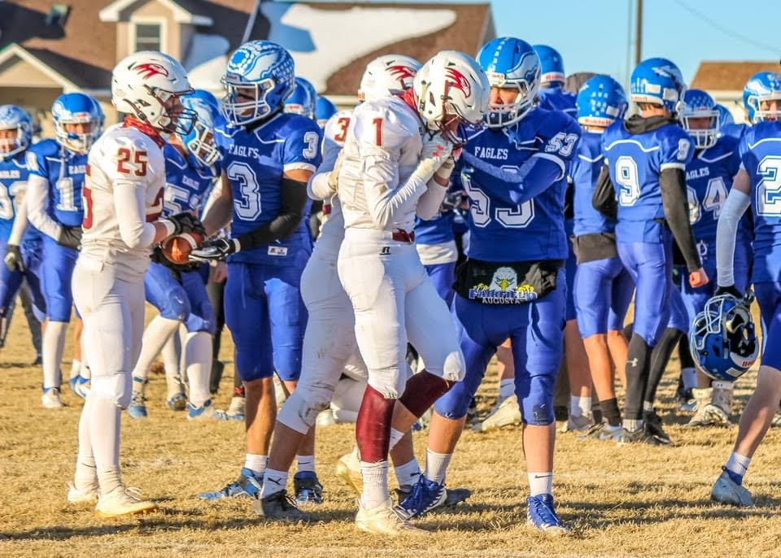

Slide 17
“They don't care how much you know until they know how much you care.”
-Jim Tressel, Ohio State

Slide 18
Every Player: Keys to success
Every player is as equally important
-95 lb. Freshman to the starting QB…. Equal
-Allows each player to feel a part of the tradition and the program.
-Each day clean up: starts with the seniors
-“Leaders Lead”

Slide 19
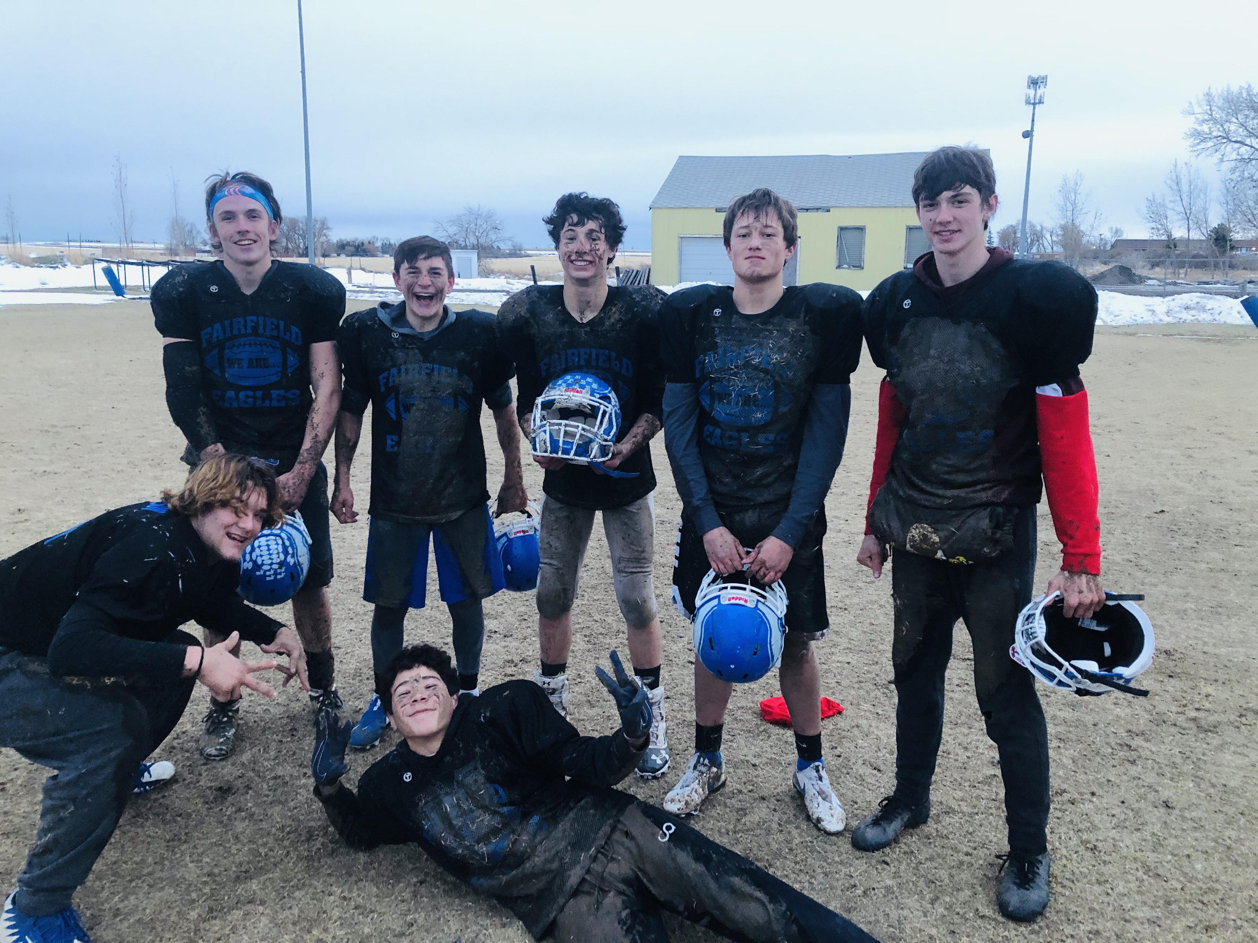
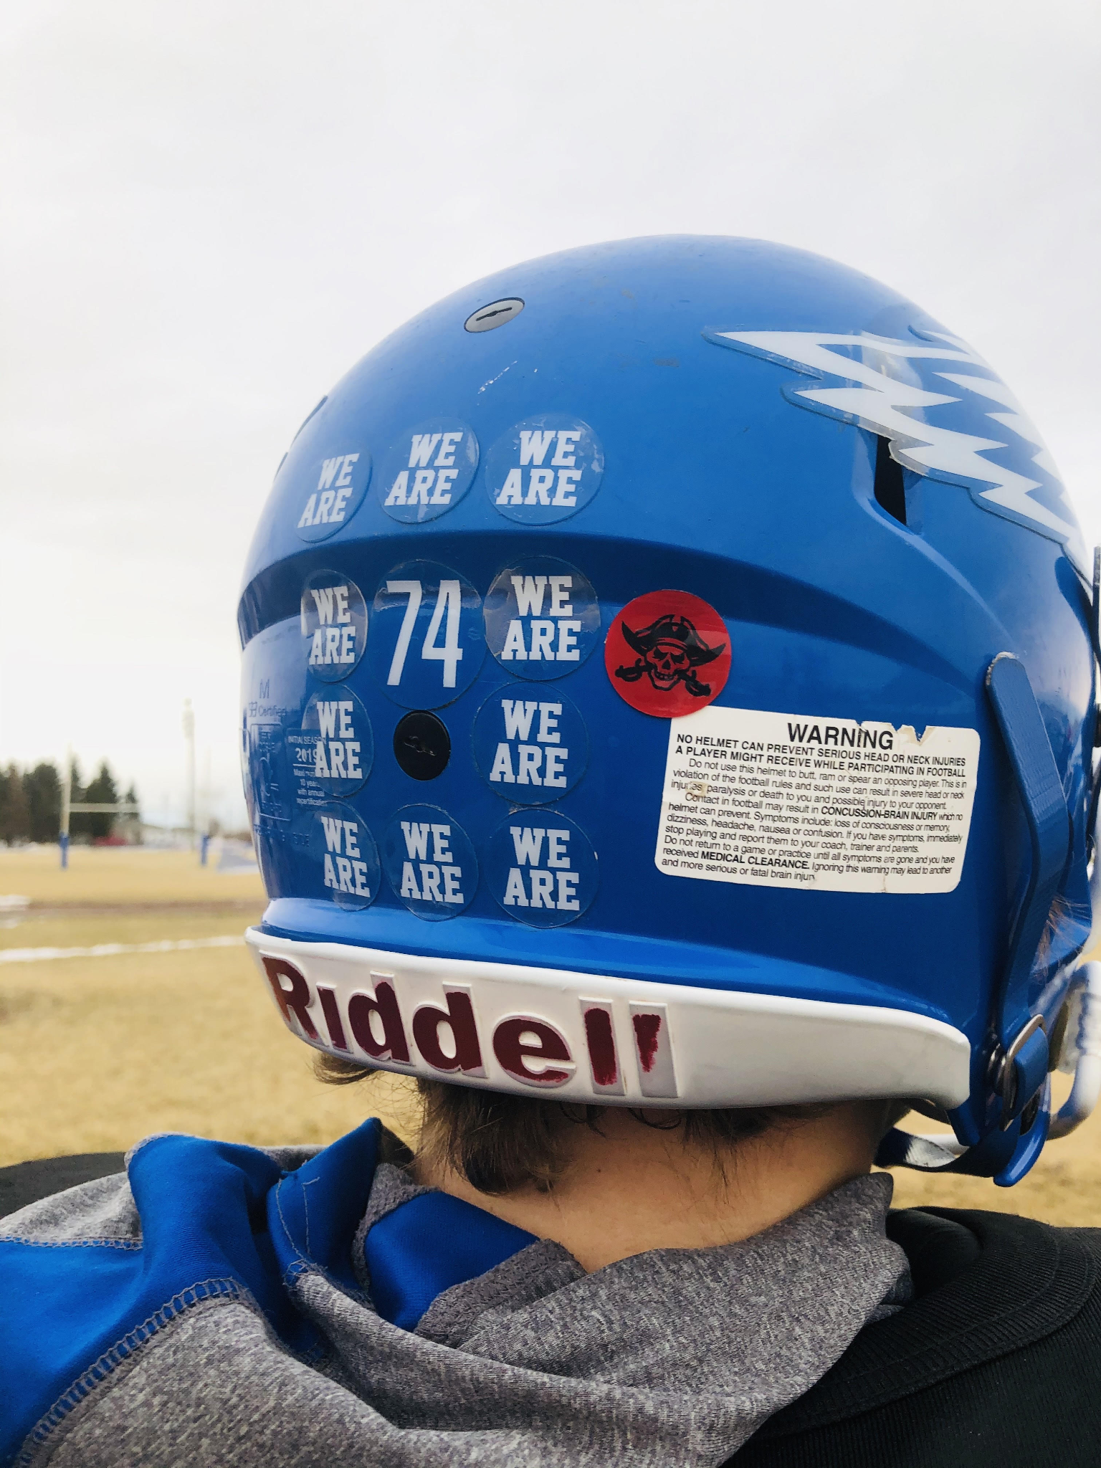
Value Your People

Slide 20
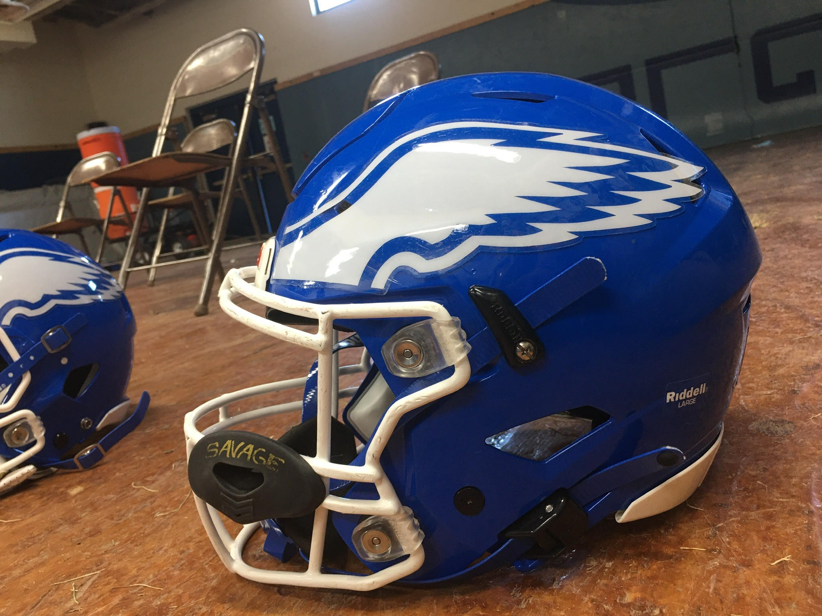
Find something unique in your program:
“Earn your wings”

Slide 21
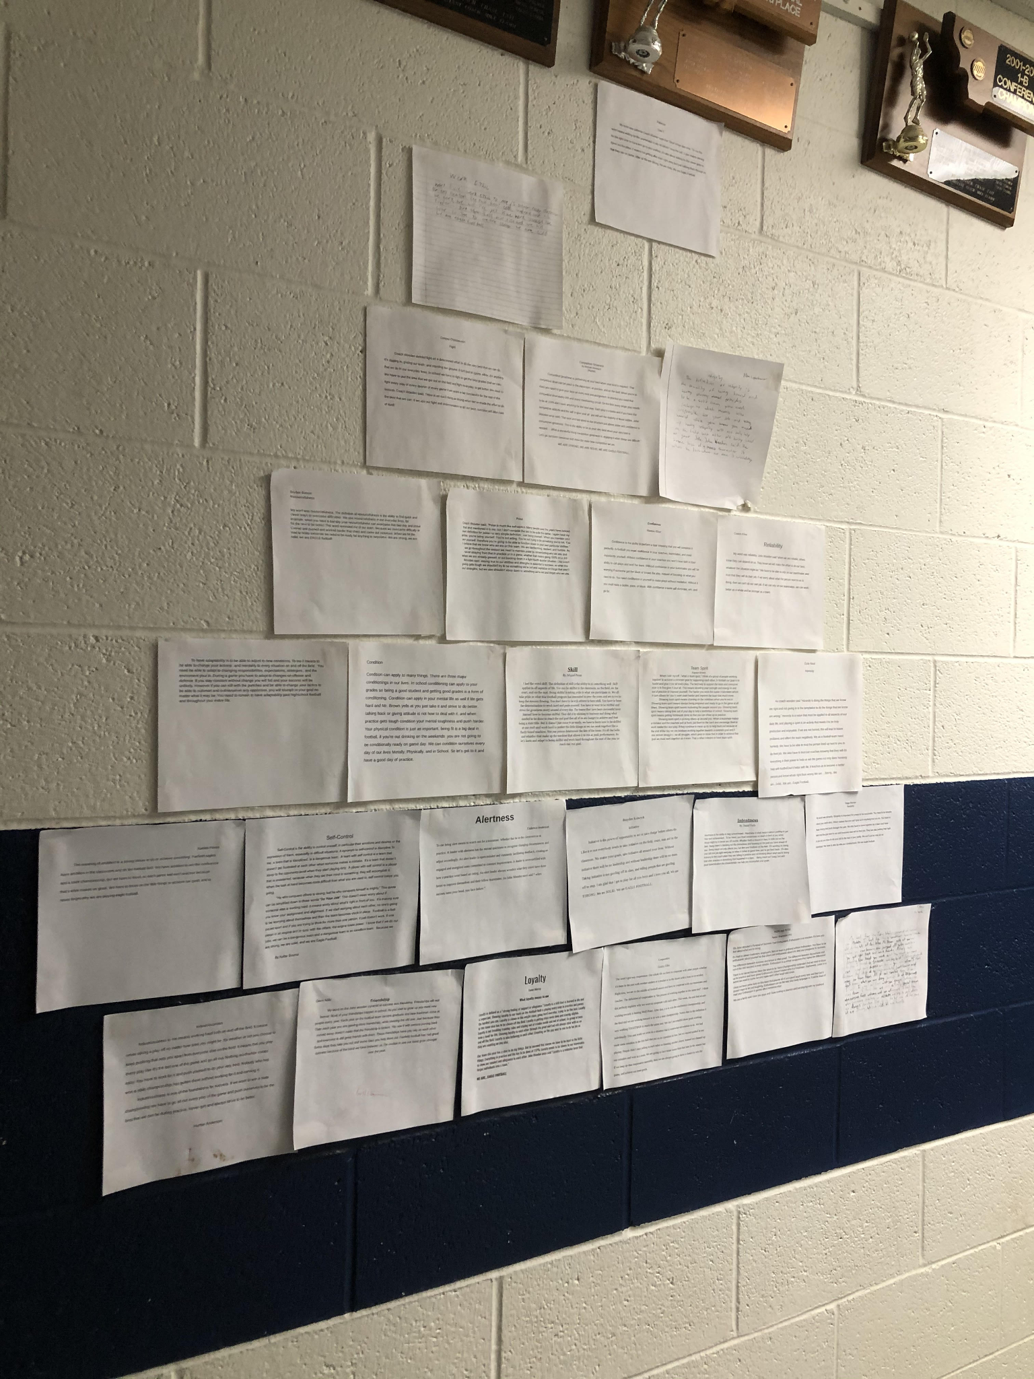
Word pyramid
Connection with their teammates
Puts players in a uncomfortable position
Walk by it everyday

Slide 22
Grading system
“Striving for perfection”
We grade our practices: -#1-10
-Practice based on effort
- Chart posted
- Players love it

Slide 23
WE ARE…. Eagle Football
We Are…. Strong
We Are…. Solid
We Are…. Eagle Football
Buy in with our players and community…. Connecting People

Slide 24
Strong:
Mentally
Ability to act in a championship manner
In the classroom and on the field
Physically
Give your best effort during your rep
Improve for yourself everyday
Outwork our competitor

Slide 25
Solid:
-Give to others
Give to your teammates
Not about your success, TEAM success
-One team, one goal
-one fails we all fail, one succeeds we all succeed.

Slide 26
WE ARE…. Eagle Football
“Refuse to lose rather than wanting to win”

Slide 27
Setting Clear Expectations: Vision
1) Committed to the process of success
-show that you care
2) Kids can tell you what it takes….
- …. but do they really know
3) Discipline to obtain the vision
-Daily grind
-Make yourself uncomfortable

Slide 28
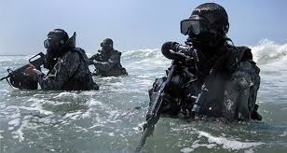
Be Elite: Navy Seal Mentality
-Best of the best
-Control what we do
-Cannot control our opponents preparation

Slide 29
Teach and Demand: Be ELITE
Demand of myself and my coaches
-Be teachers not screamers
-Coaching is teaching
-set clear expectations for the drill
- make it your best rep
- Coaching is not criticism
We need to look past the best athletes abilities and focus on each player becoming their best.

Slide 30
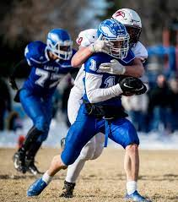
Effort doesn't take athletic ability

Slide 31
New age of communication:
-kids want information now
-my kid watches kids play video games on Youtube
-Twitter/ Facebook/ Instagram
“Can’t use Jordan and Bird”
-James vs. Curry
Team video before film session
-5-7 minutes

Slide 32
Thank You
Have a great season
gmisner@fairfield.mt.k12.us
Refuse to lose mentality

