Slide 1
Tomato? 6x200m
Tomauto? 6x200m
Training VS. Conditioning: What are you thinking?

Slide 2
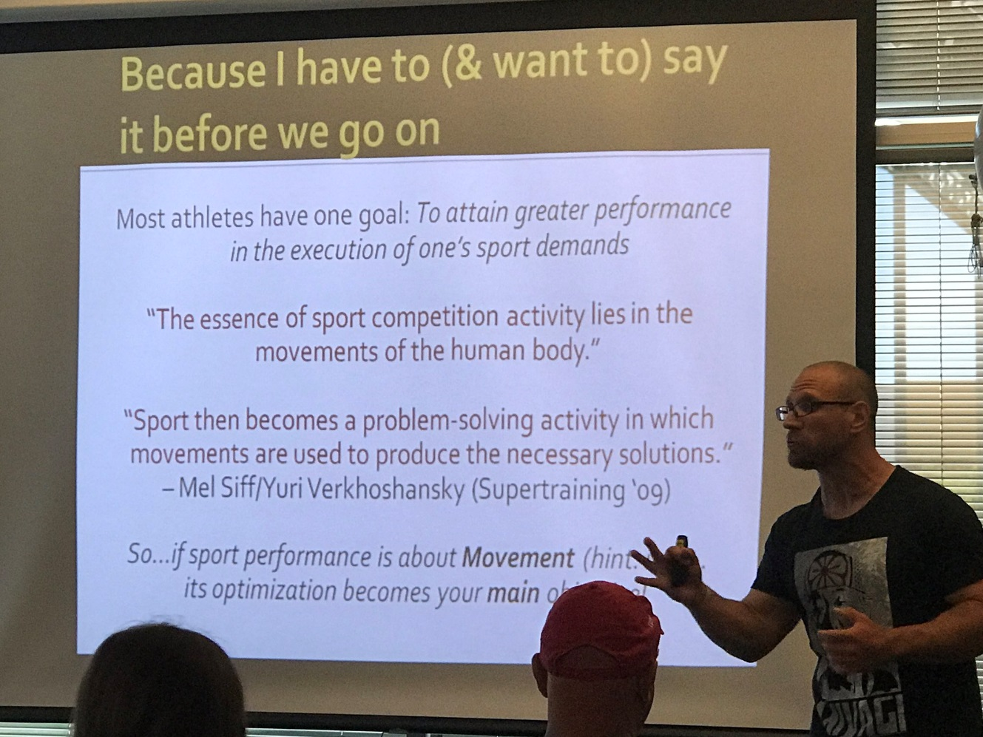
What is Your definition?
Training
Conditioning
What is your Philosophy? Shawn Myszka: Movement Mastery(The art of optimizing Movement)

Slide 3
What is our definition?
Training
Conditioning
The education, instruction, or discipline of a person or thing being trained.
Sports specific training is simply fitness and performance training designed specifically for athletic performance enhancement.
Specific skills are those skills that are practiced for the sport an athlete use them for.
Bio-motor abilities are the areas that affect all aspects of training. (speed, strength, endurance, flexibility and coordination)
To make a person or animal fit and healthy.
The application of a structured training program to prepare cardiovascular, muscular and psychological readiness in humans, canine and equine athletes for competition or strenuous events.
Improvement of physical health by a program of exercises. (Physical Conditioning)
The process of training that results in physical fitness and the state of physical fitness that results from such training.

Slide 4
Bio-Motor Development:
Bio-motor Skills
1.Speed 2.Strength 3.Endurance 4.Flexibility 5. Coordination
All very important to long term athletic development!

Slide 5
Specific Training Sport specific training is simply fitness and performance training designed specifically for athletic performance enhancement.
Specific Skills(The importance of Coordination)
Sports preparation is necessary for the sport specific skills and physical preparation is needed for specific performance enhancement such as foot speed, strength, power, etc.

Slide 6
Motor Coordination
Motor coordination is the combination of body movements created with the kinematic (such as spatial direction) and kinetic (force) parameters that result in intended actions. Motor coordination is achieved when subsequent parts of the same movement, or the movements of several limbs or body parts are combined in a manner that is well timed, smooth, and efficient with respect to the intended goal
So very important
When teaching and working on coordination of movement, the athlete will need to go through a series of progressions. These progressions should go from slow to fast and or simple to complex movement patterns. Meaning, the coach/trainer should break down each movement pattern. Allowing the athlete to learn the simplest movement and slowly progress to a more complex movement pattern.

Slide 7
Enhancements from working on Motor coordination; +Timing +Rhythm +Sequencing +Efficiency +Reactivity +Learning of more advanced movements +Confidence

Slide 8
Metabolic Conditioning Energy System Training:
Anaerobic System(ATP, CP) 10 seconds
Without Oxygen
Glycolysis
(Blood glucose/Muscle Glycogen) 30 sec-2 minutes
Aerobic Energy System( Krebs Cycle, Glucose, Glycogen and Fats)
With Oxygen
What System are you running?

Slide 9
Neuromuscular Training: Pertaining to nerves and muscles and the relationship between them.
Central Nervous System(strength/explosiveness, power/plyometric)
Muscular System(resistance training/muscular endurance)
and
How do the nerves and cells interact with the Muscles?

