Slide 1
#LIKEAGIRL
Understanding and working with the female athlete
Kylie M Izzi MS, ATC/LAT, CSCS, ITAT, USAW-1

Slide 2
Where to start
Long Term Athlete Development Model (LTADM)
Peak Velocity Height (PVH)
LTADM and the Female
Motivational Theories
Common injuries
Missing pieces?
What can we be doing differently with strength and conditioning and flexibility

Slide 3
The athlete
Middle and High school athletes guided by the Long Term Athlete Development Model and Peak Height Velocity

Slide 4
Long Term Athlete Development Model
Model based on Developmental age of athlete
Age of athlete based on Peak Velocity Height (PVH)
Outlines age categories
Identifies the need for development of sports skills
Neurocognitive and physical capabilities
Offer places for coaches to start, allows for a timeline and progression
Help with limiting specialization too early
Provides training goals for general and sport specific skills

Slide 6
The middle school athlete
Age 11-14
Learn to Train
Speed window 2 (females 11-13+)
Aerobic stamina (females 11-14, males 12+)
Strength training- body weight, medicine balls, swiss balls
Development of Core sports skills, speed, agility, short sprints, core
Coordination of movements
Growth spurt typically last 18-24 months
Tell what is to be done, not what you don’t want done

Slide 7
The high school athlete
9-12th grade ages 14-18
ALTD- learn to compete (female 15-18 males 16-18)
Train to train 11- 15
Continue to develop seep, strength and stamina, maintain flexibility
Learn to compete 15-18
Develop sport skills
Reduction in number of sports
Focus becomes competition and outcome

Slide 8
Growth and Development
The female's body shape will begin to change. There may be an increase not only in height and weight, but the hips may get wider as well. There may also be an increase in fat in the buttocks, legs, and stomach. These are normal changes that may happen during puberty. (university of Rochester Medical school)
Anywhere from 10-14 years old , lasting up to 2 years to complete (depending on source)
Can be later in athletes
Reports of early onset in recent years
URMS also states “body size will increase, with the feet, arms, legs, and hands beginning to grow in advance of the body. This may cause the adolescent girl to experience a time of feeling clumsy”

Slide 9
PVH and trainng?
“Physical performance is commonly measured as the outcome of motor task requiring speed, agility, strength and power [3, 9]. However, the rapid increases in body dimensions and muscle hypertrophy during adolescence suggest that movement proficiency may be affected as athletes negotiate with fluctuating levels of co-ordination (i.e. the sudden increase in body size is likely to affect co-ordination)” [10].
“As a result of the physical changes that accompany adolescence, both males and females may struggle to perform simple motor task such as balancing, running and change of direction task [1]. Coaches must be mindful of this and allow athletes to develop new strategies and solutions in essentially a ‘new’ body” [10].

Slide 10
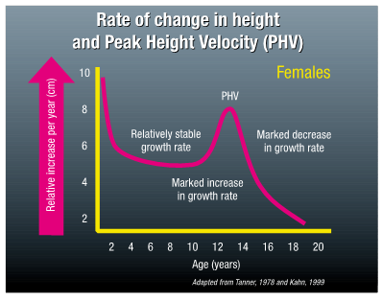
Peak Velocity Height
Evidence of hormonal changes
Measure of maximum rate of growth during growth spurt
Girls grow 2 years before males
Girls PVH ≈ 12 years old
Girls will weigh more than boys due to increase estrogen and fat mass
Allows for implementation of training windows
Pre
During
Post

Slide 11
PVH and training
Endurance
Just prior to PVH and slowly introduced after
Assumption as to why? (overuse, muscle imbalance, change in hips)
Strength
Immediately after PVH or menarche
S/C recommendations
12 years or old
Dynamic movements
Core and stabilization of the trunk, development of the stabilization musculature
Speed
Phase 1
6-8 years old less than 5 seconds
Phase 2
11-13 years old 5-120 seconds in duration

Slide 12
Differences between males and females

Slide 13
Natural Tendencies
Female
Male
Free organized play everyone has an equally important role
Inclusive and caring play
Quite and calm
Deep connection
Compassion
Praise
Free Unorganized play geared towards winner and looser
Searching for a leader, qualities are strength, and power
Naturally competitive
Loud

Slide 14
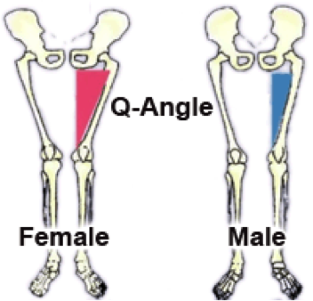
differences between males and females
Not small males
Not small adults
Different development (LTADM)
Biology prevails
Giving Berth
Endurance (mitochondria)
Biomechanical differences
Q-angle (hip widening)
Hormonal differences and influence
Communication and connection is key

Slide 15
Women are drivin’ to win, just in a very female way…

Slide 16
Its really quite simple . . .
According to UNC Soccer coach Anson- Men respond to strength and your capacity to lead . . . Some male coaches do this by being physically, psychologically or verbally intimidating”. . . Anson further states “women aren’t led by that, in fact, if you lead that way athletically you will ultimately end up intimidating them. It causes a loss of confidence and separation. Women respond to our humanity, so you lead women with your capacity to care and capacity to relate. Connection is critical. . . They don’t want me to use speeches with words like “fury”, they don’t want me to raise my voice or get in their face. They want me to care about them. They want me to relate to them personally.” Hardball for women in the workplace pg 59

Slide 17
theories

Slide 18
Motivational Theories
Multiple theories on how to motivate
Multifaceted and multi layered
Group and individual components
The ability to relate is what makes a great coach
Up to the coach as a grown up to be aware and able to adjust in approach

Slide 19
Motivational theories
Conceptual framework that describes how/what motivates people
1959 White coined the term effectance
Explore and influence ones environment
Intrinsic connection to environment
Efficacy and pleasure
1970 Susan Harter Competence motivation theory
Achievement domains
Cognitive
Social
Physical

Slide 20
Competence Motivation Theory
If mastery attempts are made AND successful along with validation from proper outside sources
= Perception of control (belief in abilities)
= Perception of performance control (Control performance)
https://psychology.iresearchnet.com/sports-psychology/sport-motivation/competence-motivation-theory/
Perception of control
+
Perception of Performance
=
Pleasure and increase of competence

Slide 21
Competence Motivation Theory continued
If mastery attempts are made and unsuccessful without validation from proper outside sources
= Perception of control (dis-belief in abilities)
= Perception of performance control ( lack of control performance)
Perception of control
+
Perception of Performance
=
Negative and lack of competence

Slide 22
COMPETANCE Motivation theory
Learning new tasks
Successful mastery attempts and praise = self rewards and mastery goals
Internal validation for self and performance
Unsuccessful task mastery and disapproving = low perception of goal and low self perception
Need for external validation for both self and performance
implementation of an environment conducive to intrinsic motivation and skill mastery, no matter the level, is more likely to provide the desired sense of perceived competence, and by extension, enjoyment (Ferrer-Caja and Weiss, 2000).

Slide 23
Athlete development and the competence motivation model
Age 4-7 general and social competence
LTAD = fun
Age 7-13
academic, athletic, social, physical appearance, and behavioral
LTAD = Learn to train and train to train
13-18 add 3 more
Close friendship, romantic relationships, and job competence
LTAD = train to train and train to compete

Slide 24
Soft, removed, or quiet female athlete
Lacking in confidence
Need more external motivation and validation
Teach from the foundation
Each session should build upon the previous day
Repetition- girls are very patient with drills
Sandwich approach
Side of “Why”?
Focus on team building, or building the coach athlete relationship
Build self esteem provide feedback
Can you help them find a “grr” factor

Slide 25
The Female way To win
Leader who is compassionate
Can lead by example
Cares- how do we do this as coaches
Vested interest
Voice fluctuations
Small groups- large groups are intimidating
Body language
Touch
Have expectations
Negativity out
Have fun

Slide 26
Common injuries for the Female athlete

Slide 27
Common Injuries
Concussion
Anterior Cruciate Ligament Tear (ACL)
Low Back Pain (LBP)
Q angle? Widening of hips?
Motor-neural contraction patterns
Coordination and movement patterns
Over training

Slide 28
Low back pain (LBP)

Slide 29
Low Back Pain (LBP)
Onset
Symptoms
Differential Diagnosis
Spondys
Cancer
Disk lesion
Return top play
Symptom provocation without injury
Strength and Conditioning to help?

Slide 30
Caution
LBP should be taken seriously and referred if there is any concern
Movements that cause pain should be stopped immediately
Foundation of movement patterns
Just because an athlete can play the sport, doesn’t mean they have the foundation to be injury free
Proper technique is of utmost importance
Correct motor-neural pathways are key component

Slide 31
Symptoms
Symptoms
Diffused low back pain
Increase of discomfort with intense activity
Relief of symptoms with rest in some cases
Deep aching pain, persistent, spontaneous
**Neuropathy should be noted and referred
Possible provocation of the symptoms if there has been no injury?
During periods of rapid growth, soft tissues such as muscles and ligaments are unable to keep pace with the rate of bone growth, resulting in muscle imbalances and a decrease in flexibility. This can place young athletes at greater risk for injury.(Purcell L)

Slide 32
Symptom Provocation cont.
Children and adolescents frequently present with diffuse, poorly localized lumbar pain in the absence of associated neurologic symptoms. (Wedderkopp, 2005)
Focal pain and neurologic symptoms are more likely to represent underlying pathology. Onset of symptoms will help differentiate between acute trauma and chronic overuse injury, postural and developmental abnormalities. K.Houghton 2010
In girls, the reporting of low back pain increases in frequency during puberty until maturity, regardless of age. Why some girls are susceptible to back pain in the early stage of puberty is unknown. (Wedderkopp N, 2005)

Slide 33
Return to play critera?
Conflicting researching, with nothing conclusive
There is insufficient evidence regarding this issue in literature to define the optimal time of return to play following treatment. (Mortazavi J, 2015)

Slide 34
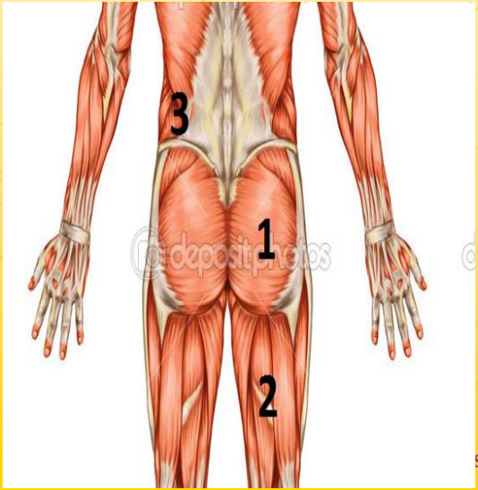
Reflection and questions
Is LBP related to menarche or associated with PVH
Is there a PVH window for menarche and the female athlete?
The way we are training is specific = NEGATIVE outcomes
Endurance training for the paraspinal and postural musculature?(EB support)
Are females using an incorrect motor neural pathway
If so, how do we train this to be correct
Why are we backing away from “scary” movements
Dead lift
Back squat
Rotational movements
Back extension

Slide 35
Strength and Conditioning?
Can we do better?

Slide 36
Be more effective with what we are already doing
Watch the way the foot interacts with the ground
Reveals hip tightness
Reveals HS tightness
More effective warm up?
Add movement screens or corrective exercises into the warm up
Pull from a variety of practices
Change it up

Slide 37
Helping or Hindering?
Nutrition
Oh boy, where to start
Sleep
How many hours
The life of a student-athlete
Are we being reasonable as a society?
Rest
Do they get enough?

Slide 38
Flexibility
Flexibility of the Hamstrings
Flexibility of the posterior chain including the upper back and par spinal muscles (erector spinae muscle endurance)
Scapularthorasic mobility
Rotational movement and strength
Hip and all that junk in the trunk

Slide 39
Functional Movements
Move in all planes of motion (frontal, sagittal, transvers)
Focus on “functional movements”
Foundation
Movement patterns
Contralateral
ipsilateral
Strength the core correctly
Reactive core training
Upper body stationary, while lower body moves
Lower body stationary, while upper body moves
Change in temp
Motor neural muscular firing patterns
Butt, Hamstring, contralateral QL is correct

Slide 40
Pearls
Connect
The relationship develops over time
Figure out what makes them tick
Explain the why
Get to their level
Let them have fun
When they come to you, give them attention
Check in and then provide space
Reward and validate

