Slide 1
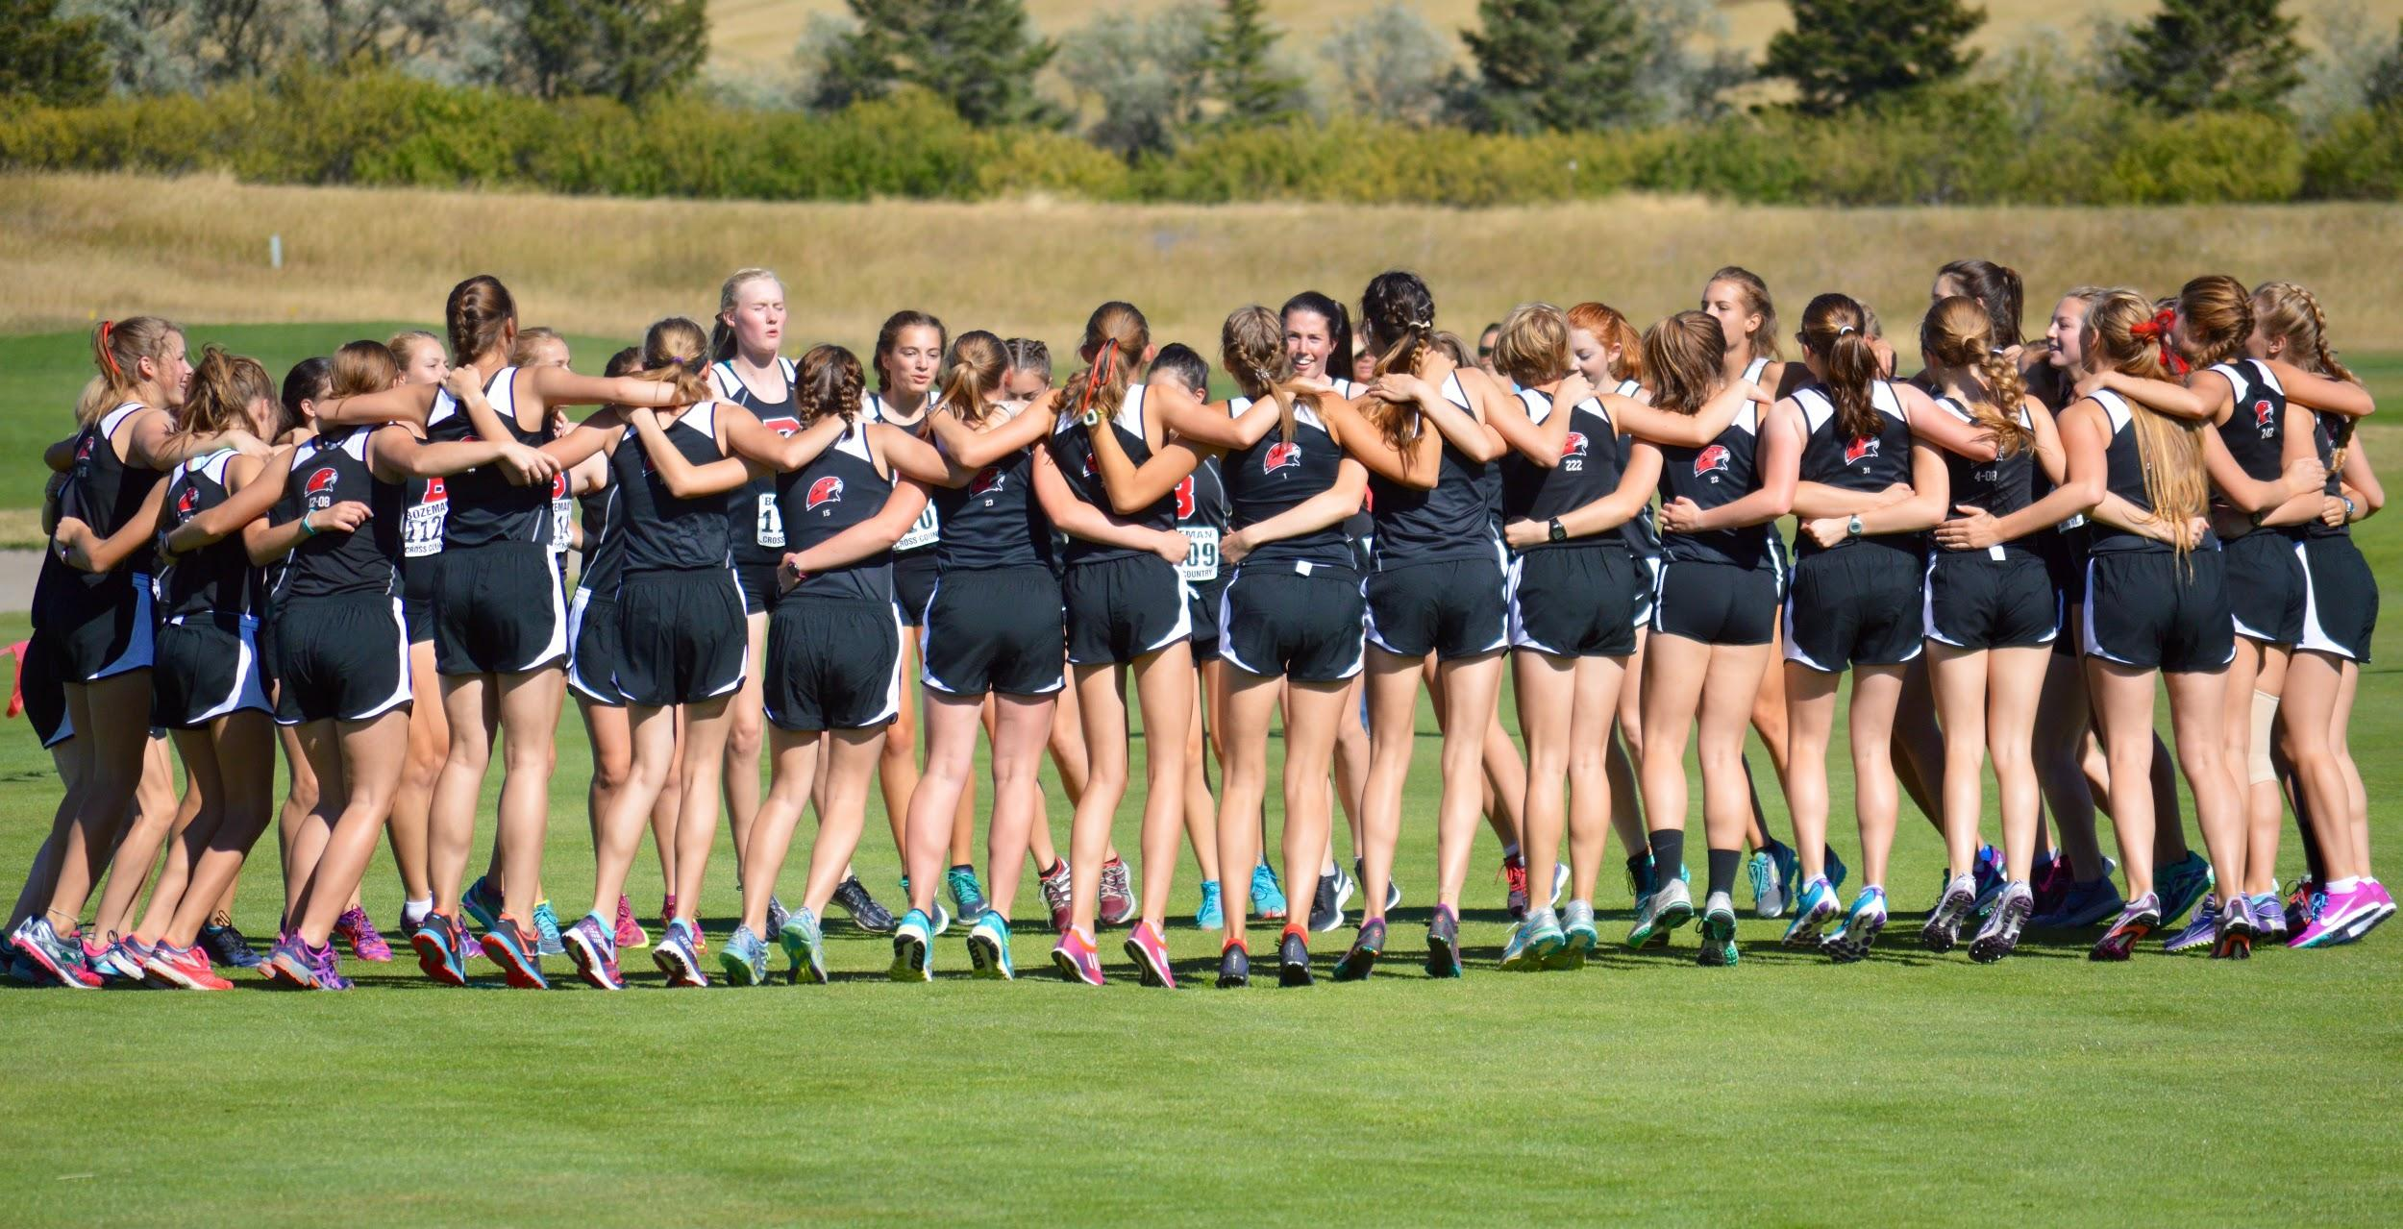
5 STEPS TO STRONG TEAM BUILDING
August 3, 2017
Casey Jermyn, Head Coach, Bozeman

Slide 2
5 Steps to Strong Team Building
Define Your Program
Build The Team
Push The Boundaries
Encourage Confidence
Foster Community Involvement

Slide 3
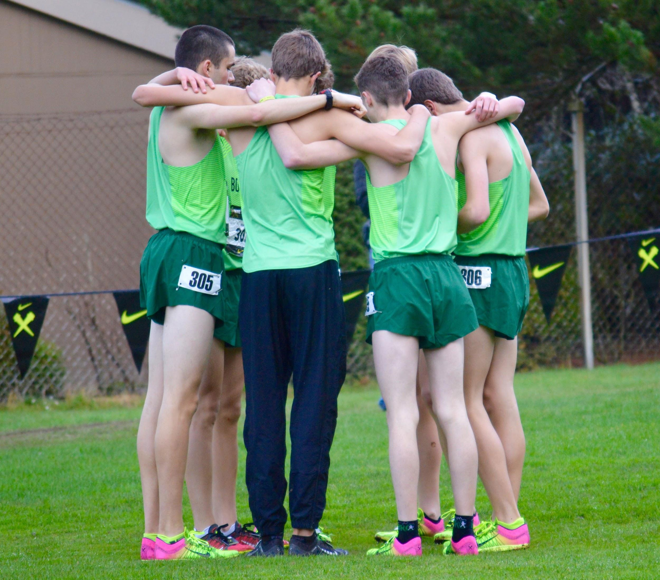
Define Your Program
→ Spend the time to determine what you want your program to embody.
2016 Bozeman Boys at Nike Cross Nationals

Slide 4
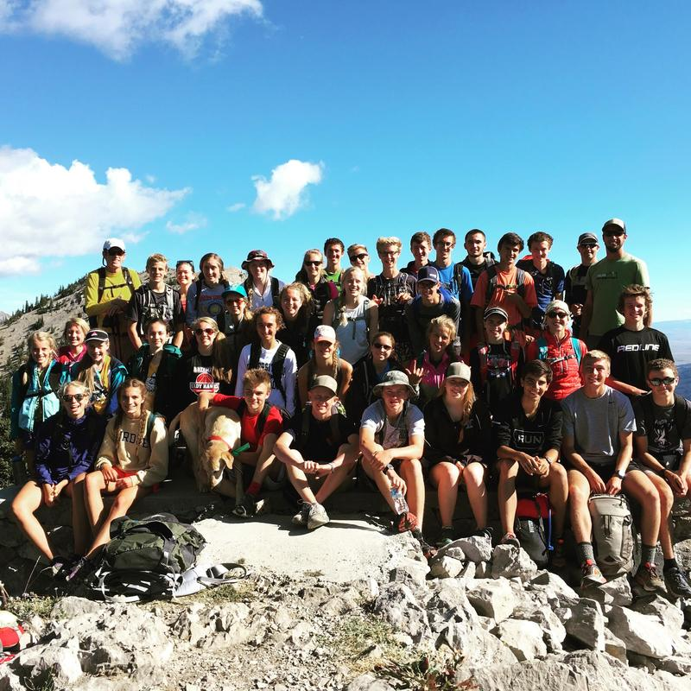
Build the Team
→ Extend past the confines of regular season through team bonding activities.
2016 Bozeman XC Team at Bridger Ridge Run

Slide 5
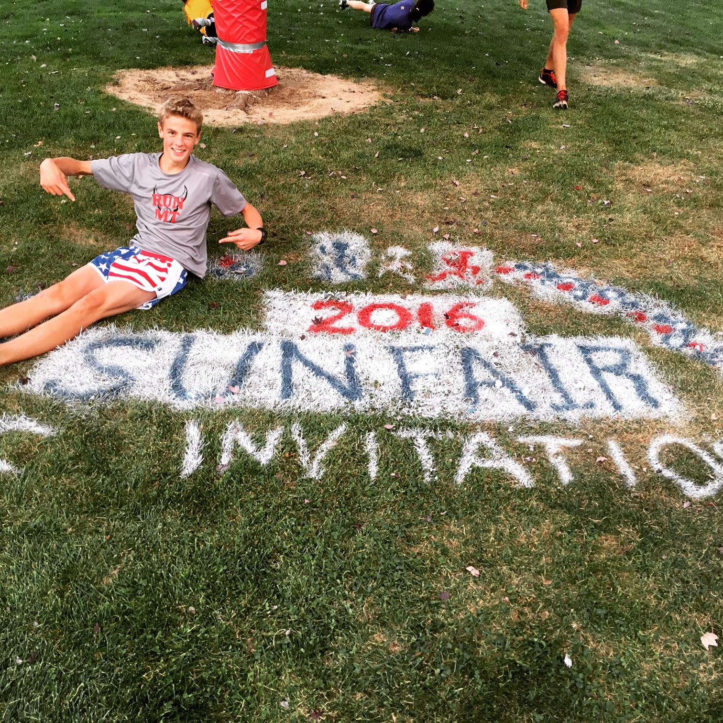
Push The Boundaries
→ Expose your team to how much of the sport lies outside of their comfort zone.
Duncan Hamilton at the 2016 Sunfair Invitational

Slide 6
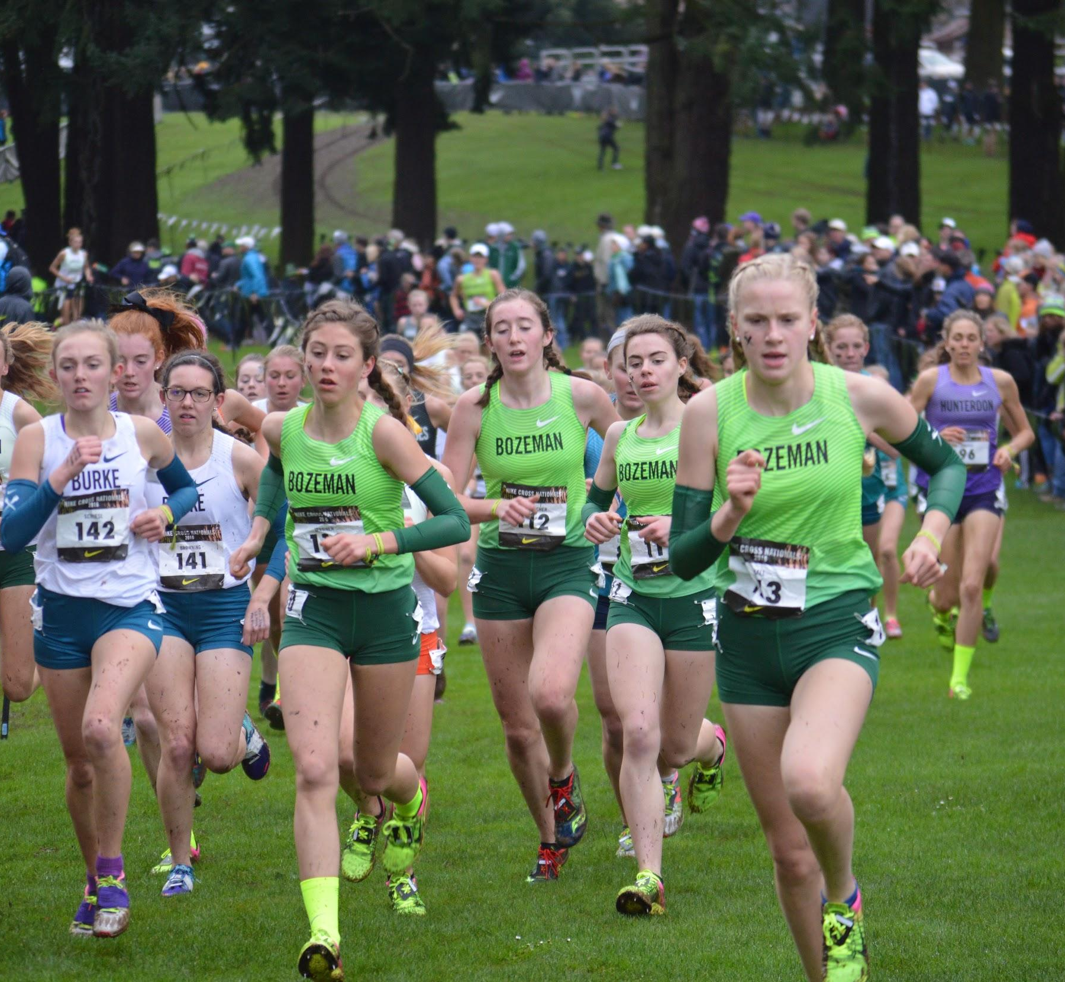
Encourage Confidence
→ Build belief in individual and team goals by doing the work...outside of competition.
2016 Bozeman Girls Team at Nike Cross Nationals

Slide 7
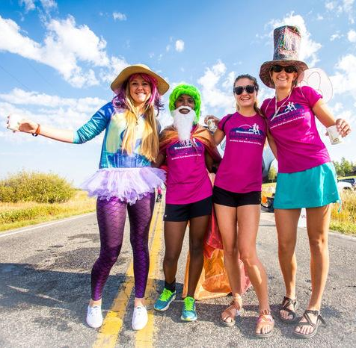
Foster Community Involvement
→ Show the team that sport & community extends beyond the high school years.
Bozeman Girls Team Volunteering at the 2016
Bozeman Marathon Event.

Slide 8
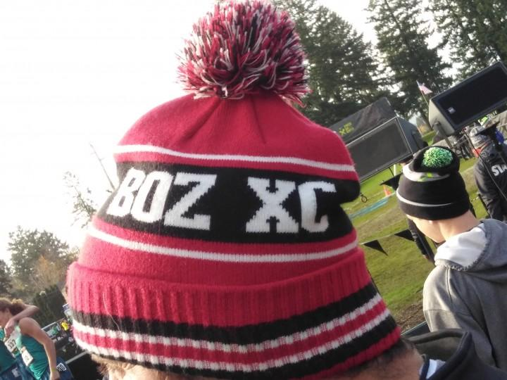
QUESTIONS?
Casey Jermyn
casey@bozemanrunningcompany.com

